Slide 1
Procedures
Mr. Sunanda Das

Slide 2
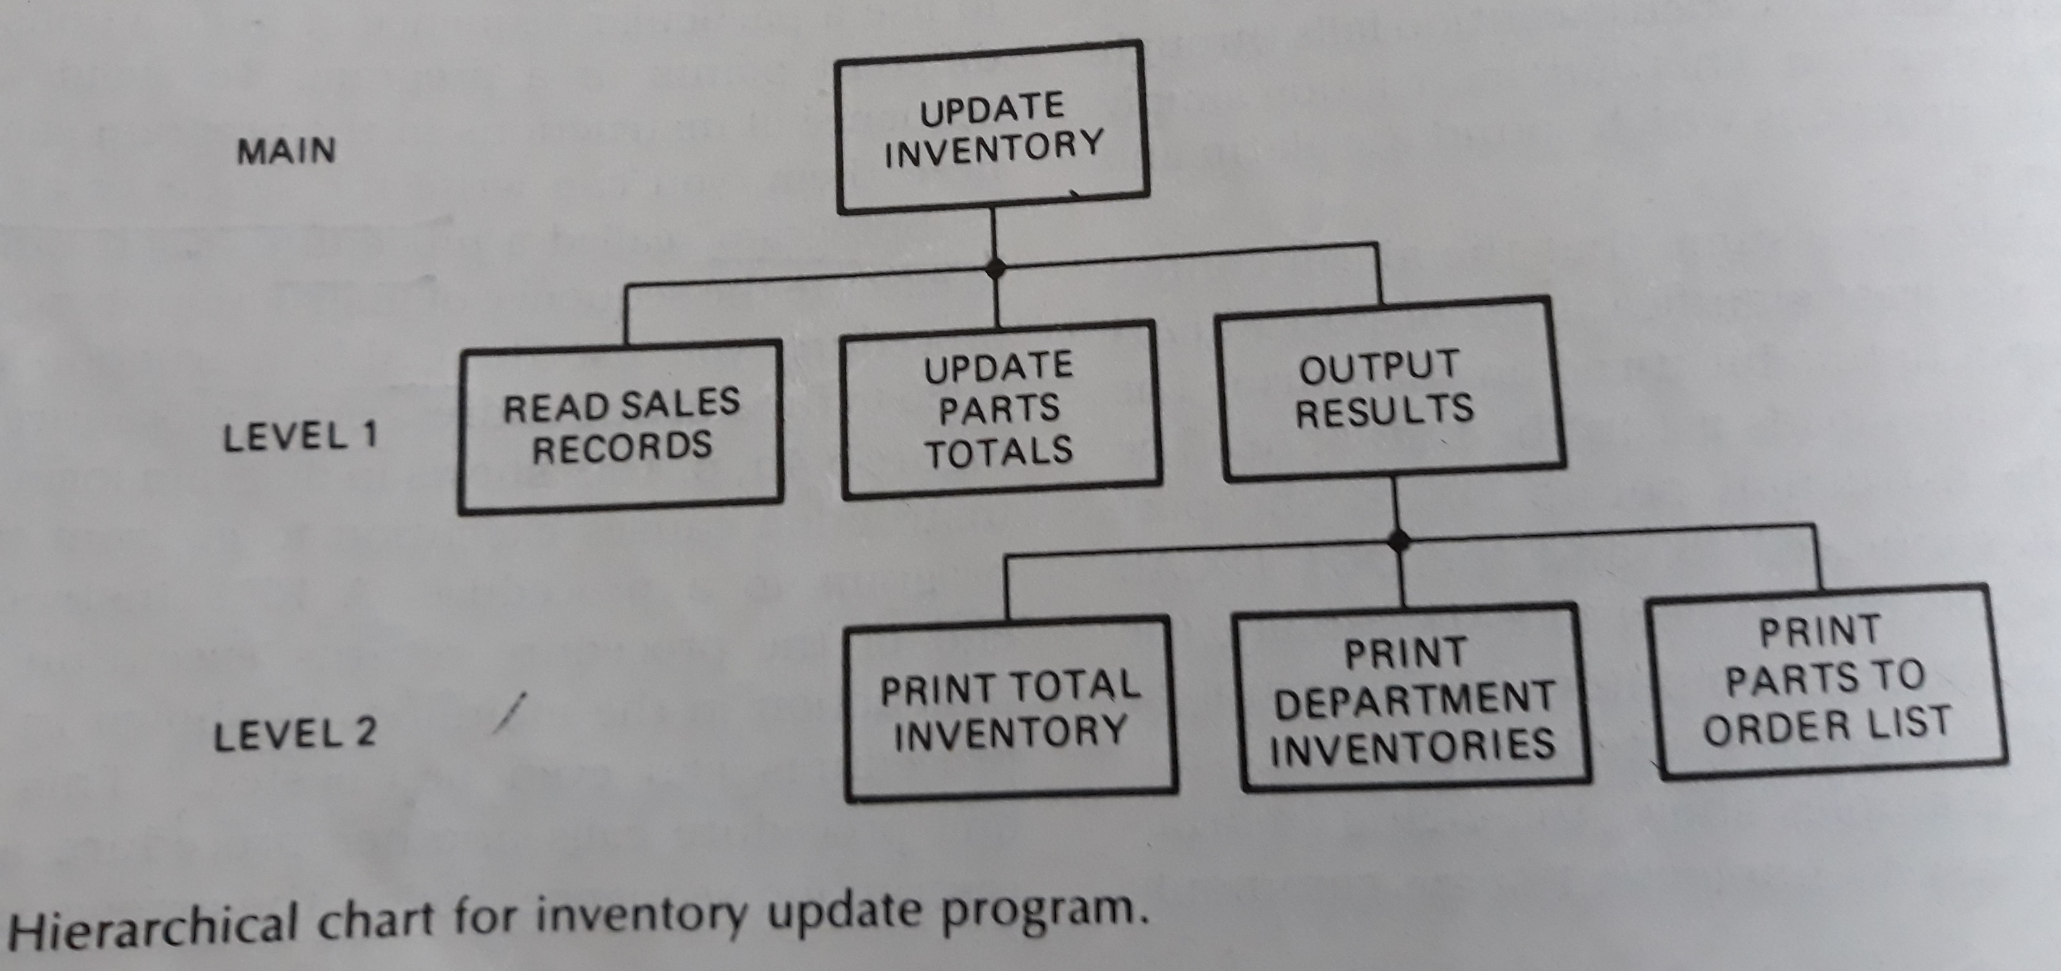

Slide 3
The 8086 CALL and RET Instruction
CALL instruction performs 2 operations.
It stores the return address on the stack
Change the contents of IP and in some cases , CS

Slide 4
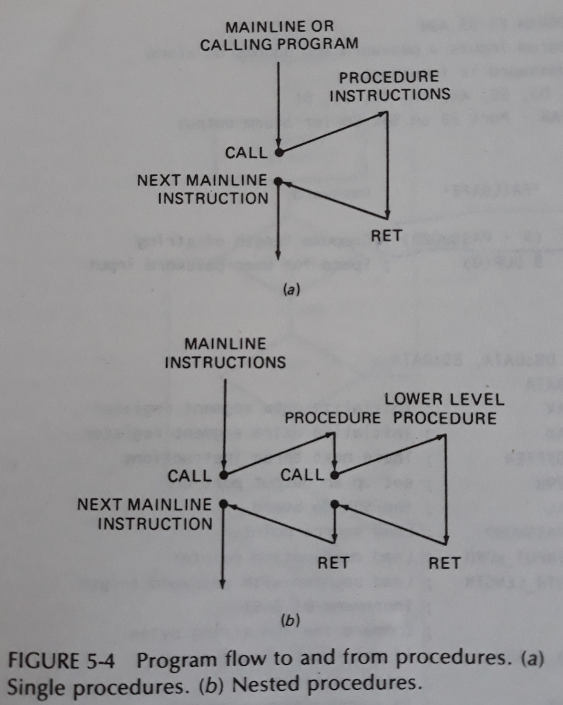
Single and Nested Procedure

Slide 5
Near CALL and Far CALL
Direct Within-Segment near call
CALL DELAY
Indirect Within-Segment near call
CALL BP
CALL WORD PTR[BX]
Direct inter-Segment Far call
Indirect inter-Segment Far call
Call DWORD PTR[BX]

Slide 6
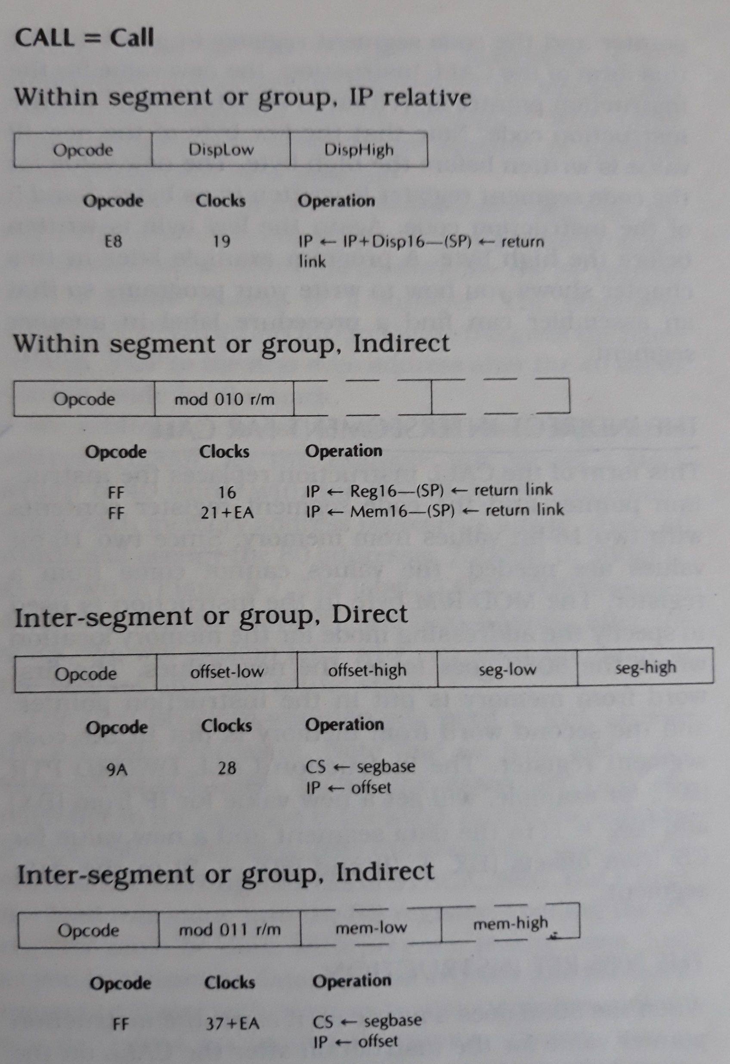
8086 CALL Format

Slide 7
RET instruction
Within segment form of RET
Normal form
SP form
Inter-segment form of RET
Normal form
SP form

Slide 8
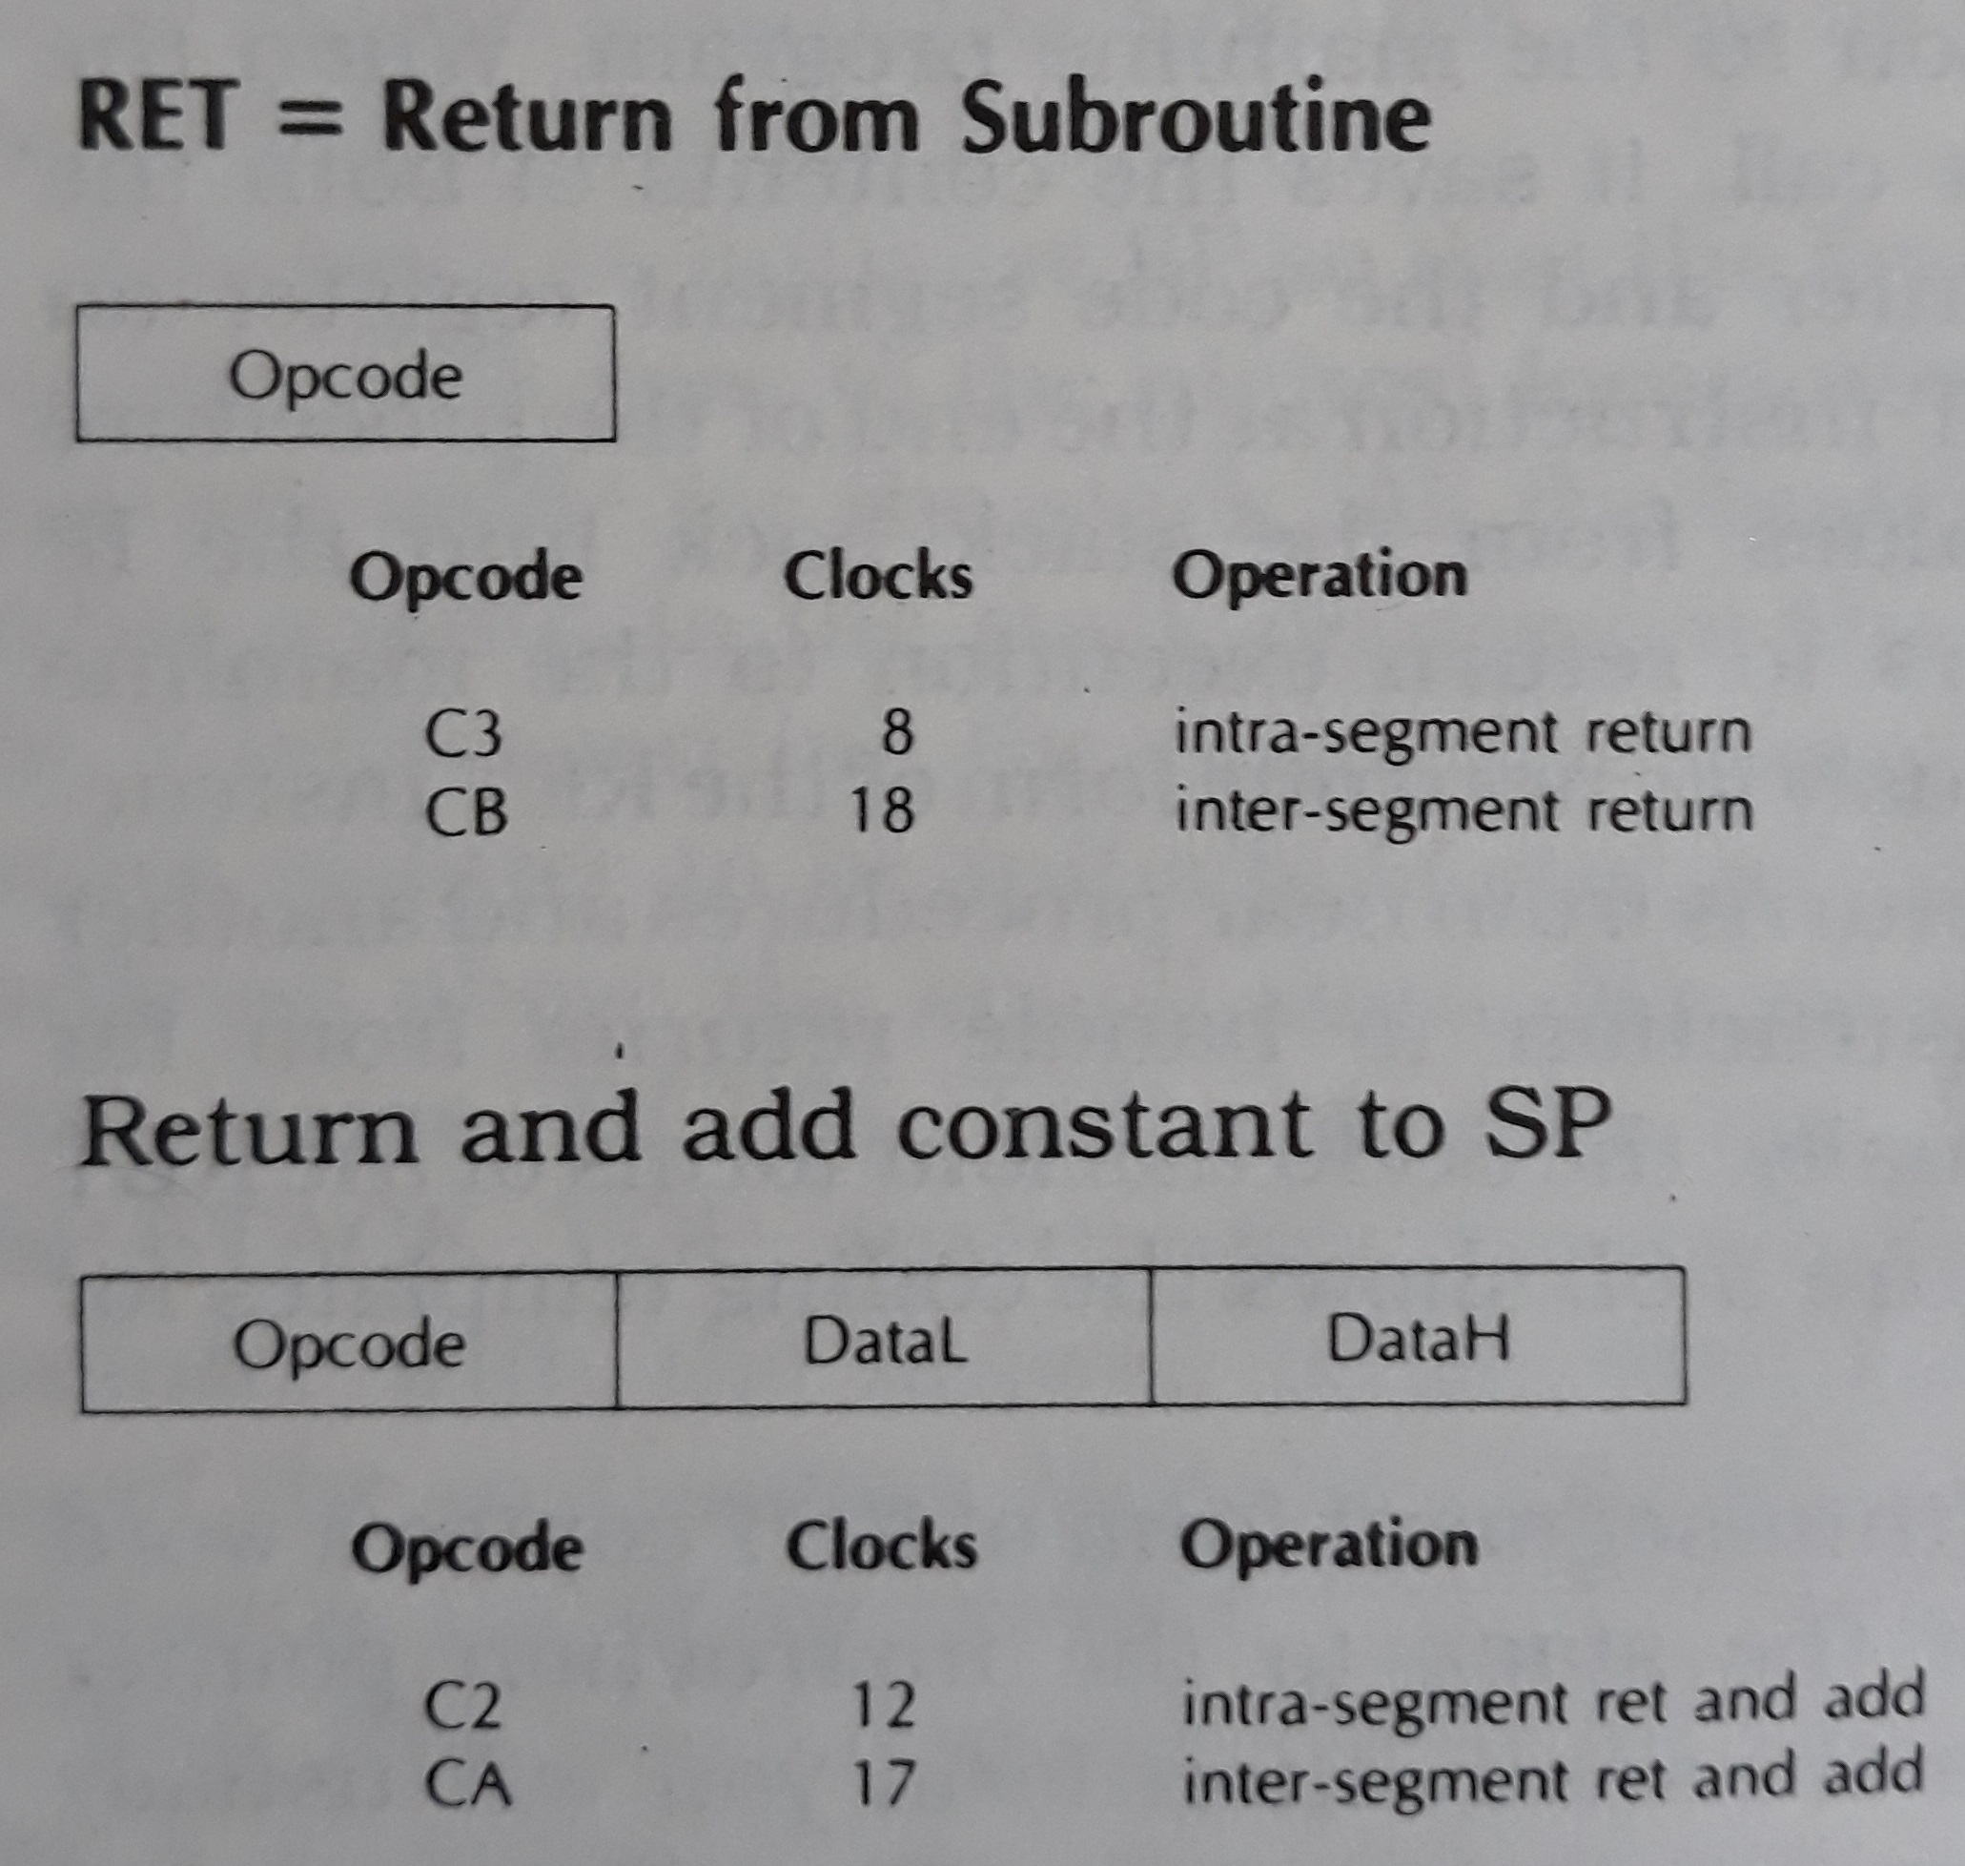
RET instruction template

Slide 9
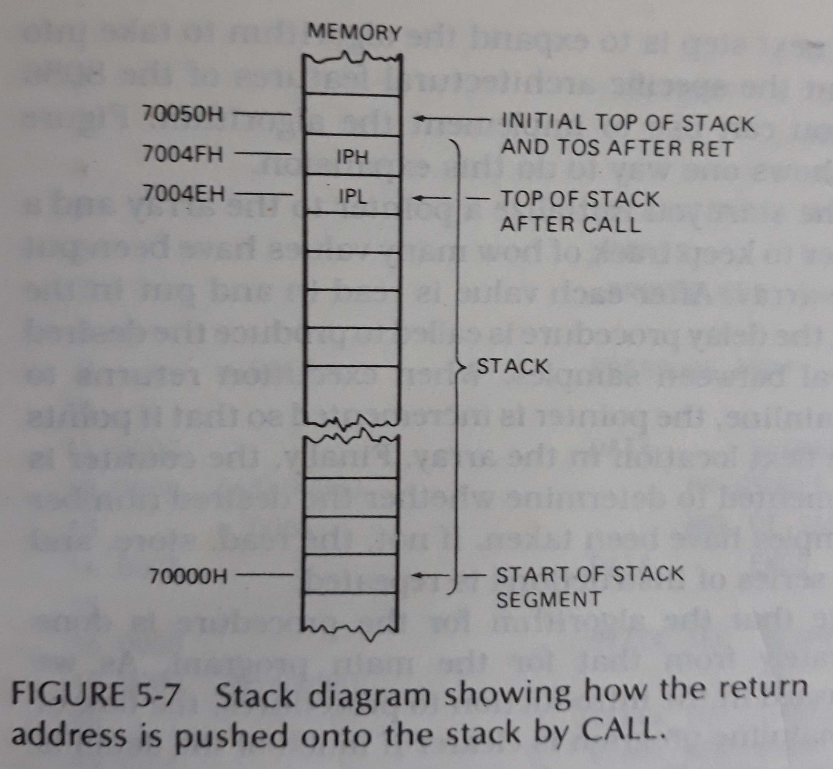
The 8086 Stack
Stores return address
Also saves the content of registers

Slide 10
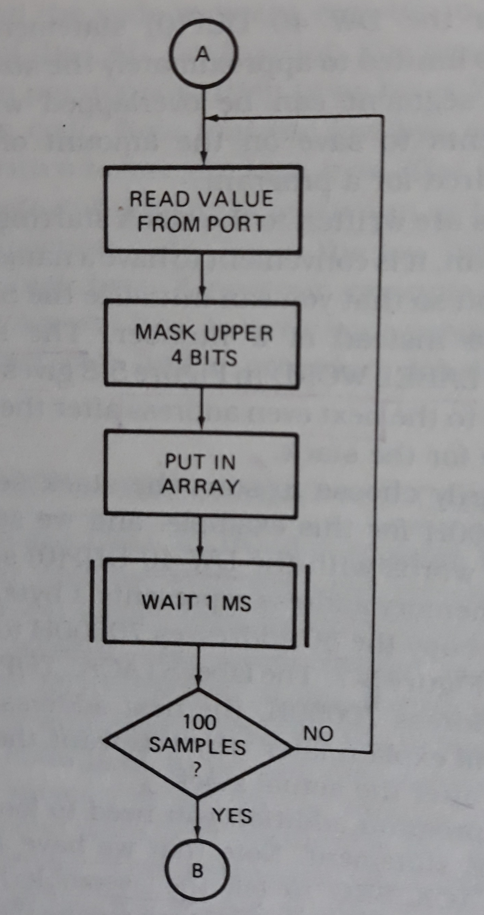
Read 100 samples of data at 1-ms interval

Slide 11
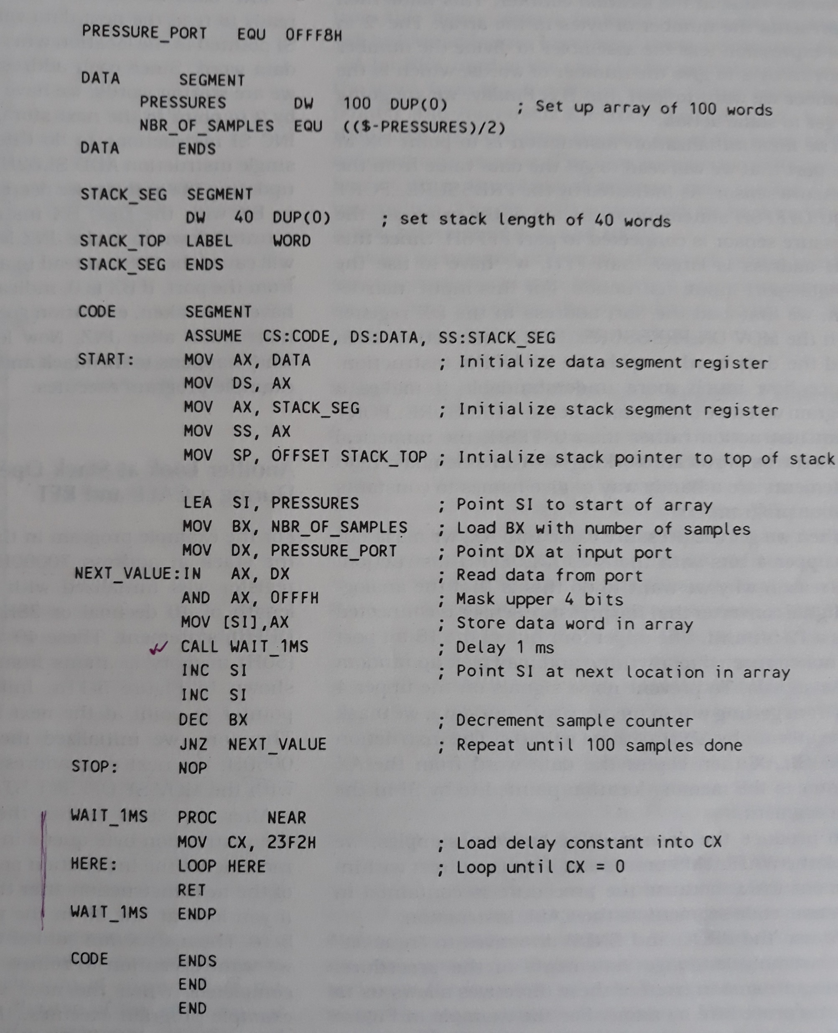

Slide 12
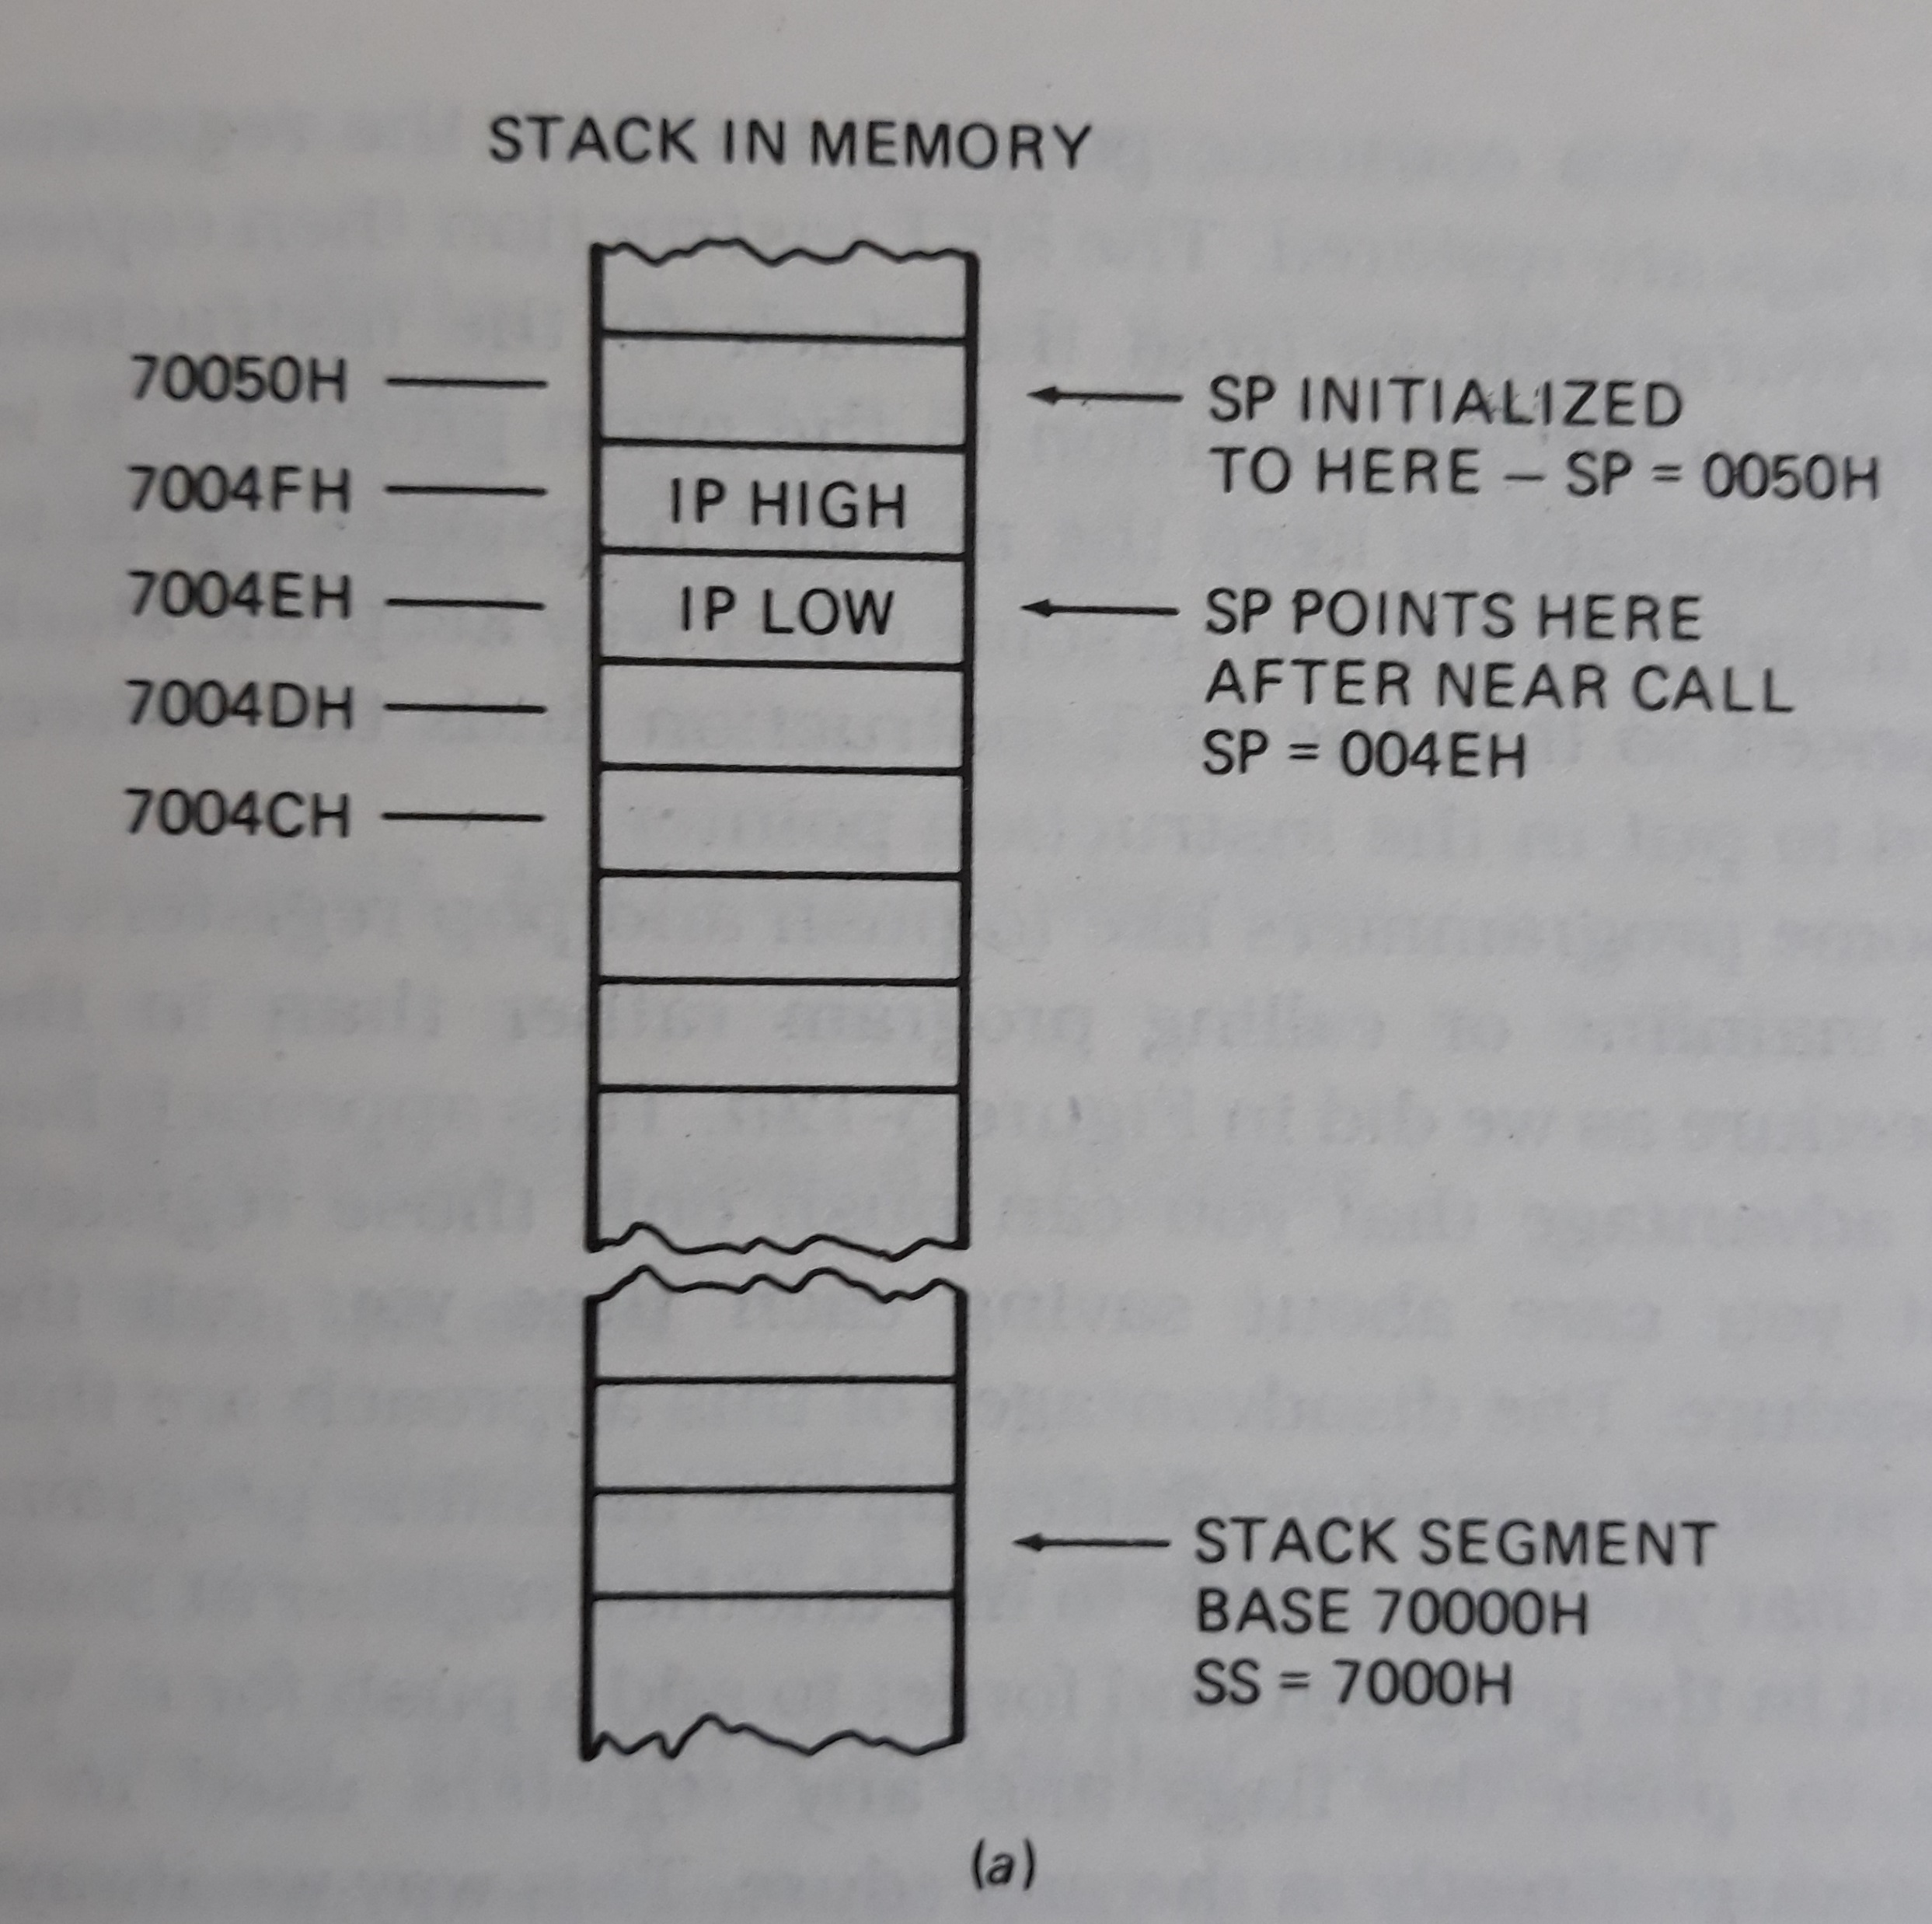
For Near CALL

Slide 13
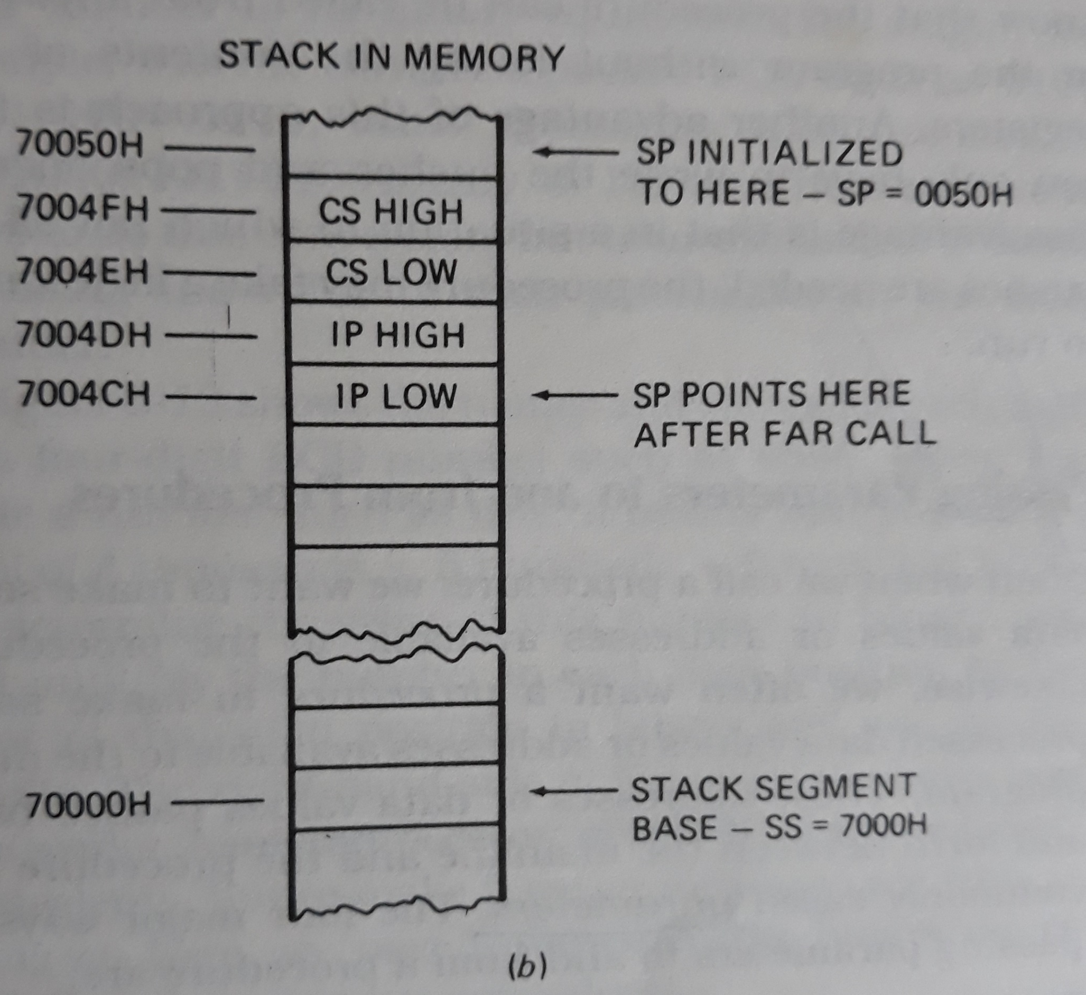
For Far CALL

Slide 14
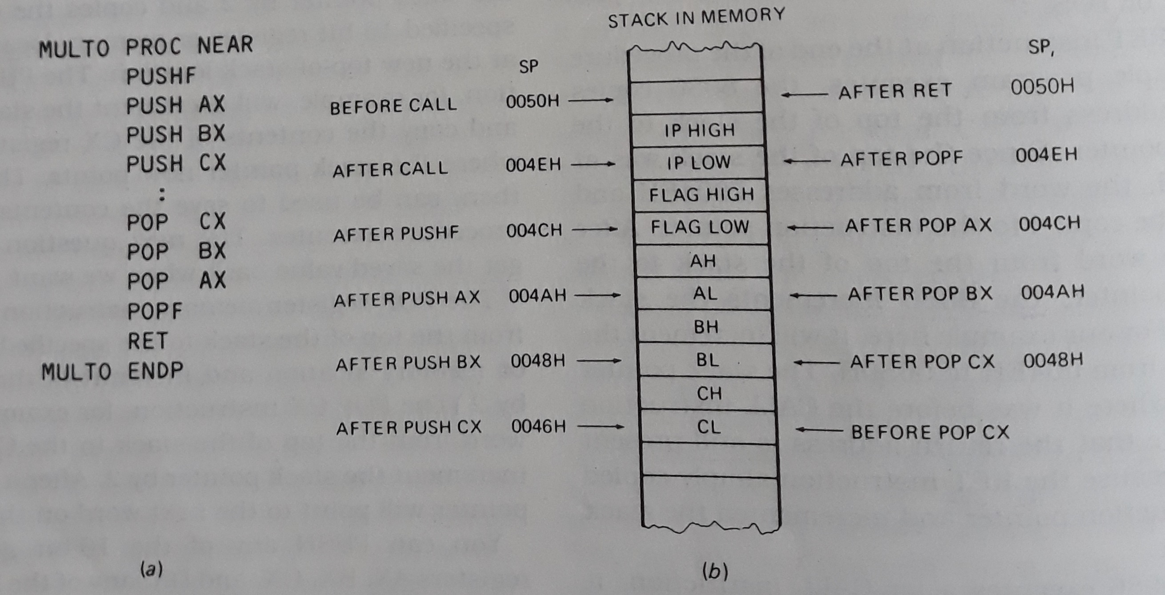
PUSH and POP instructions

Slide 15
Passing Parameters to and from Procedures
4 major ways:
Passing parameters in registers
Passing parameters in general memory
Passing parameters using pointers
Passing parameters using the stack

Slide 16
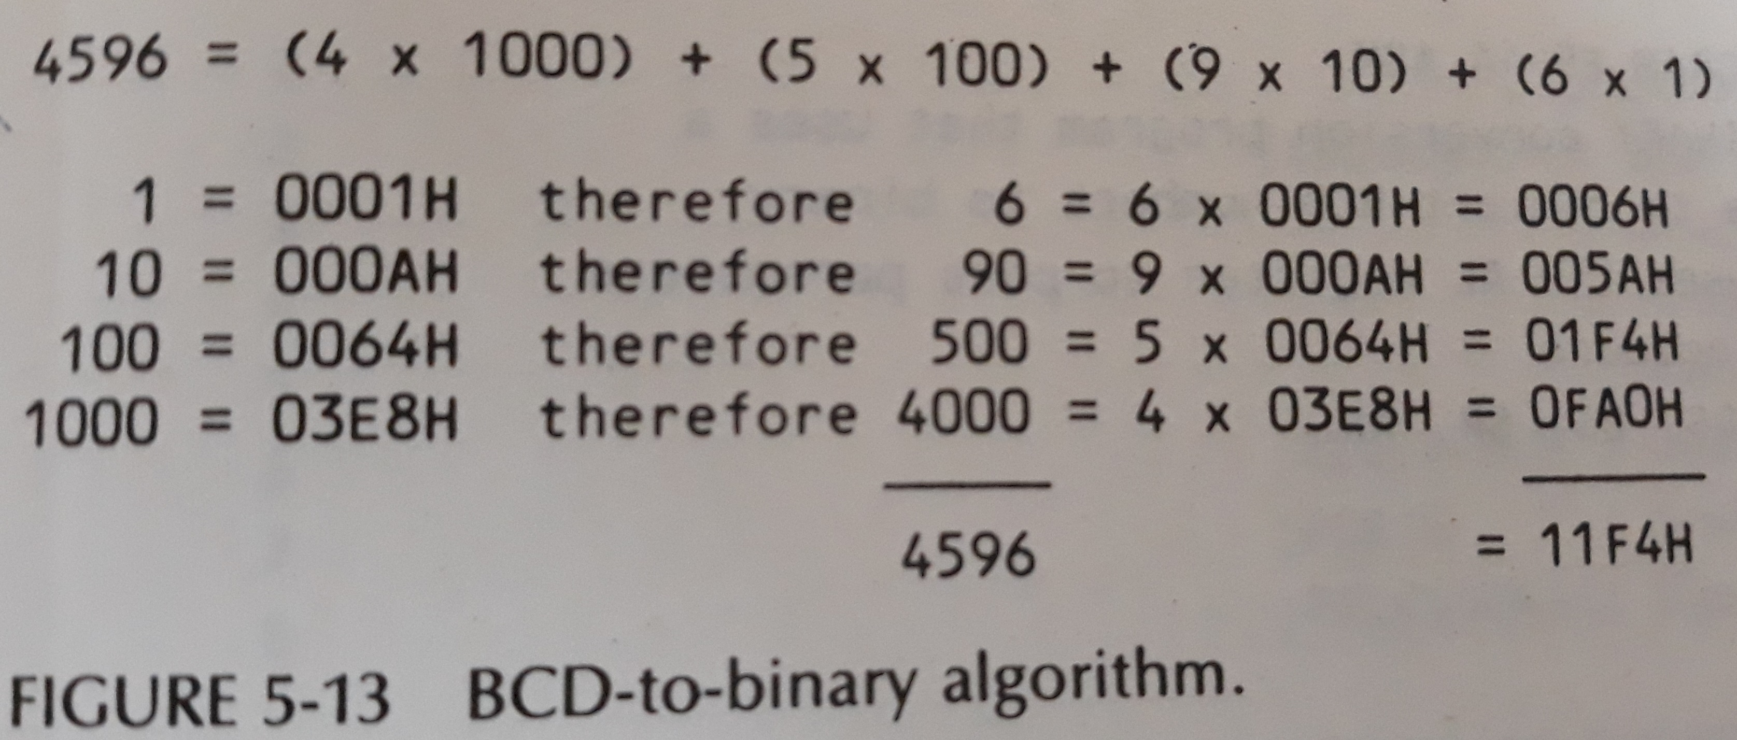
BCD to Binary

Slide 17
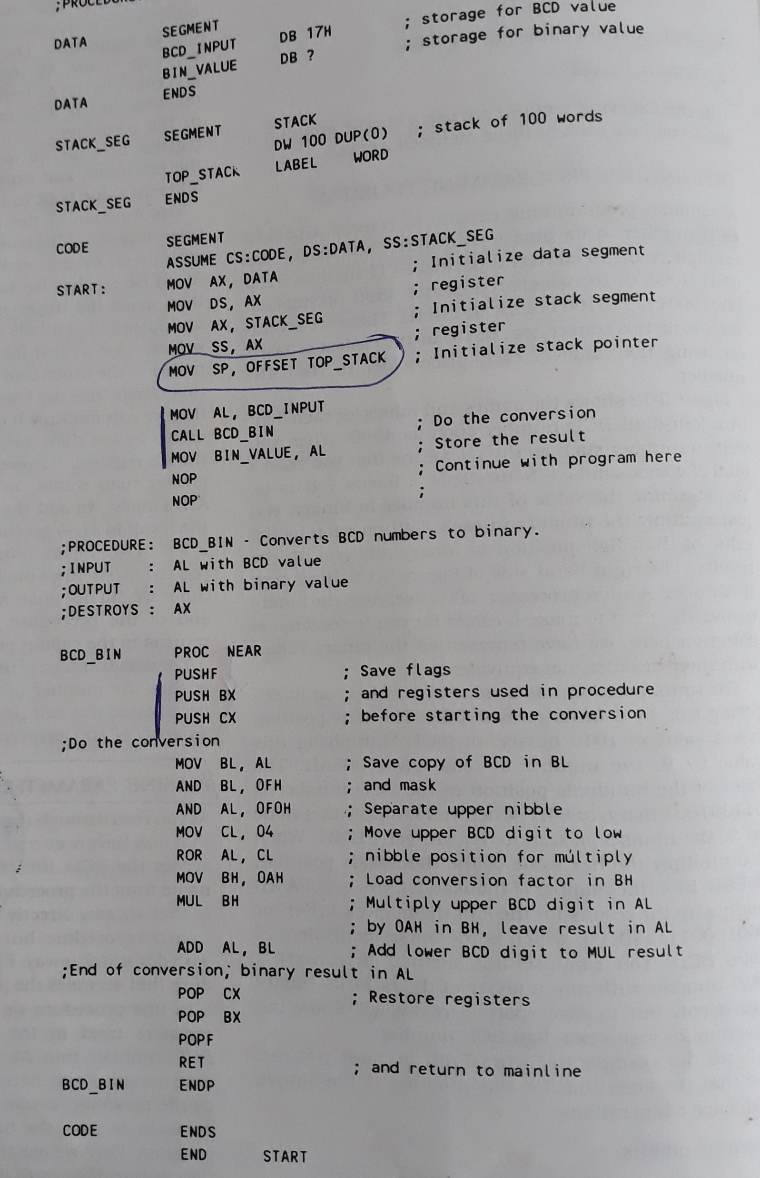

Passing parameters in registers

Slide 18
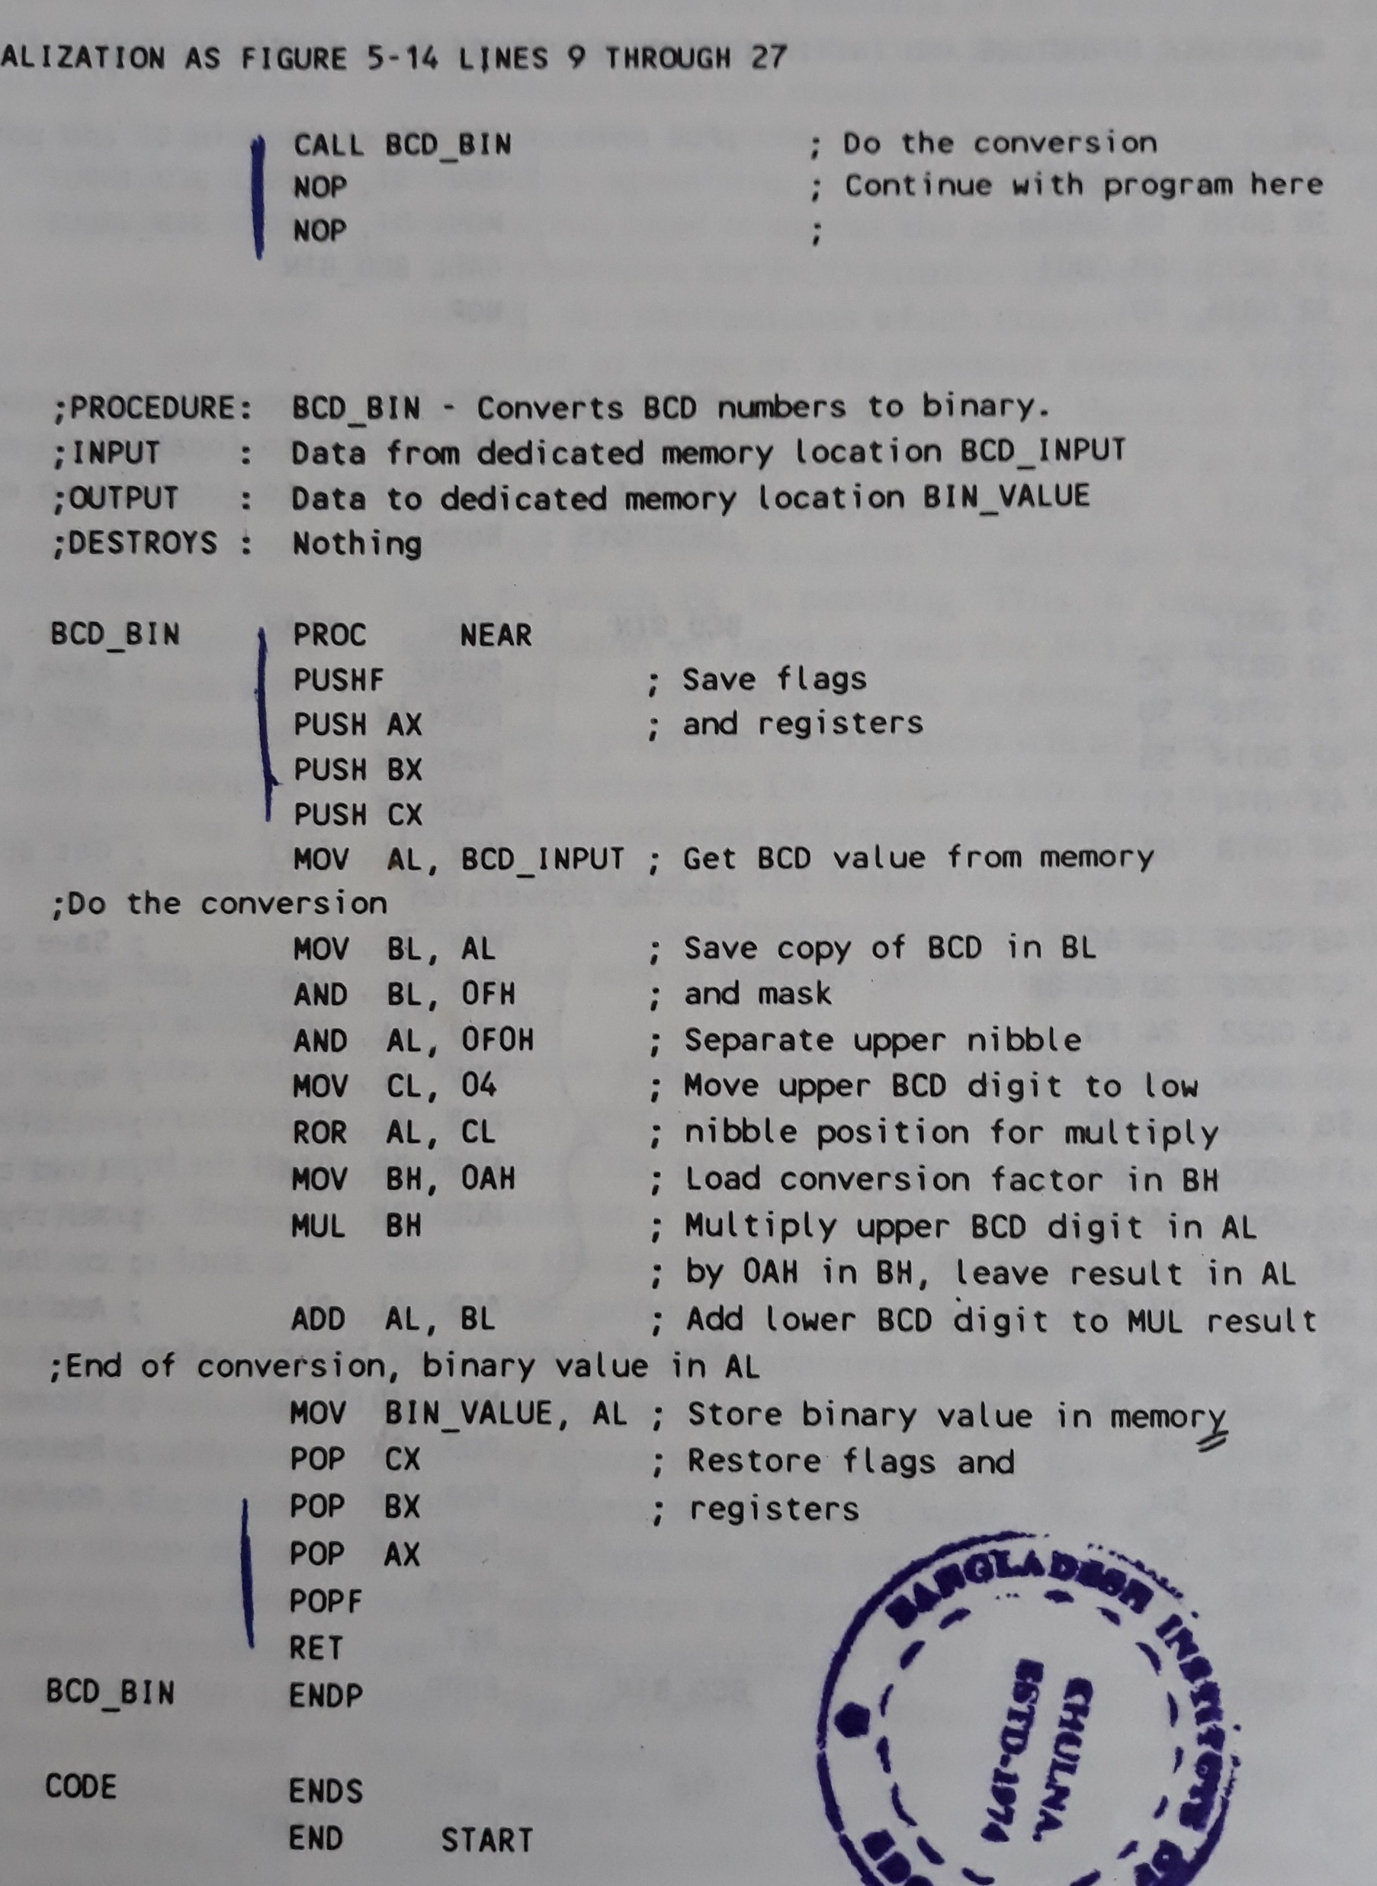
Passing parameters in general memory

Slide 19
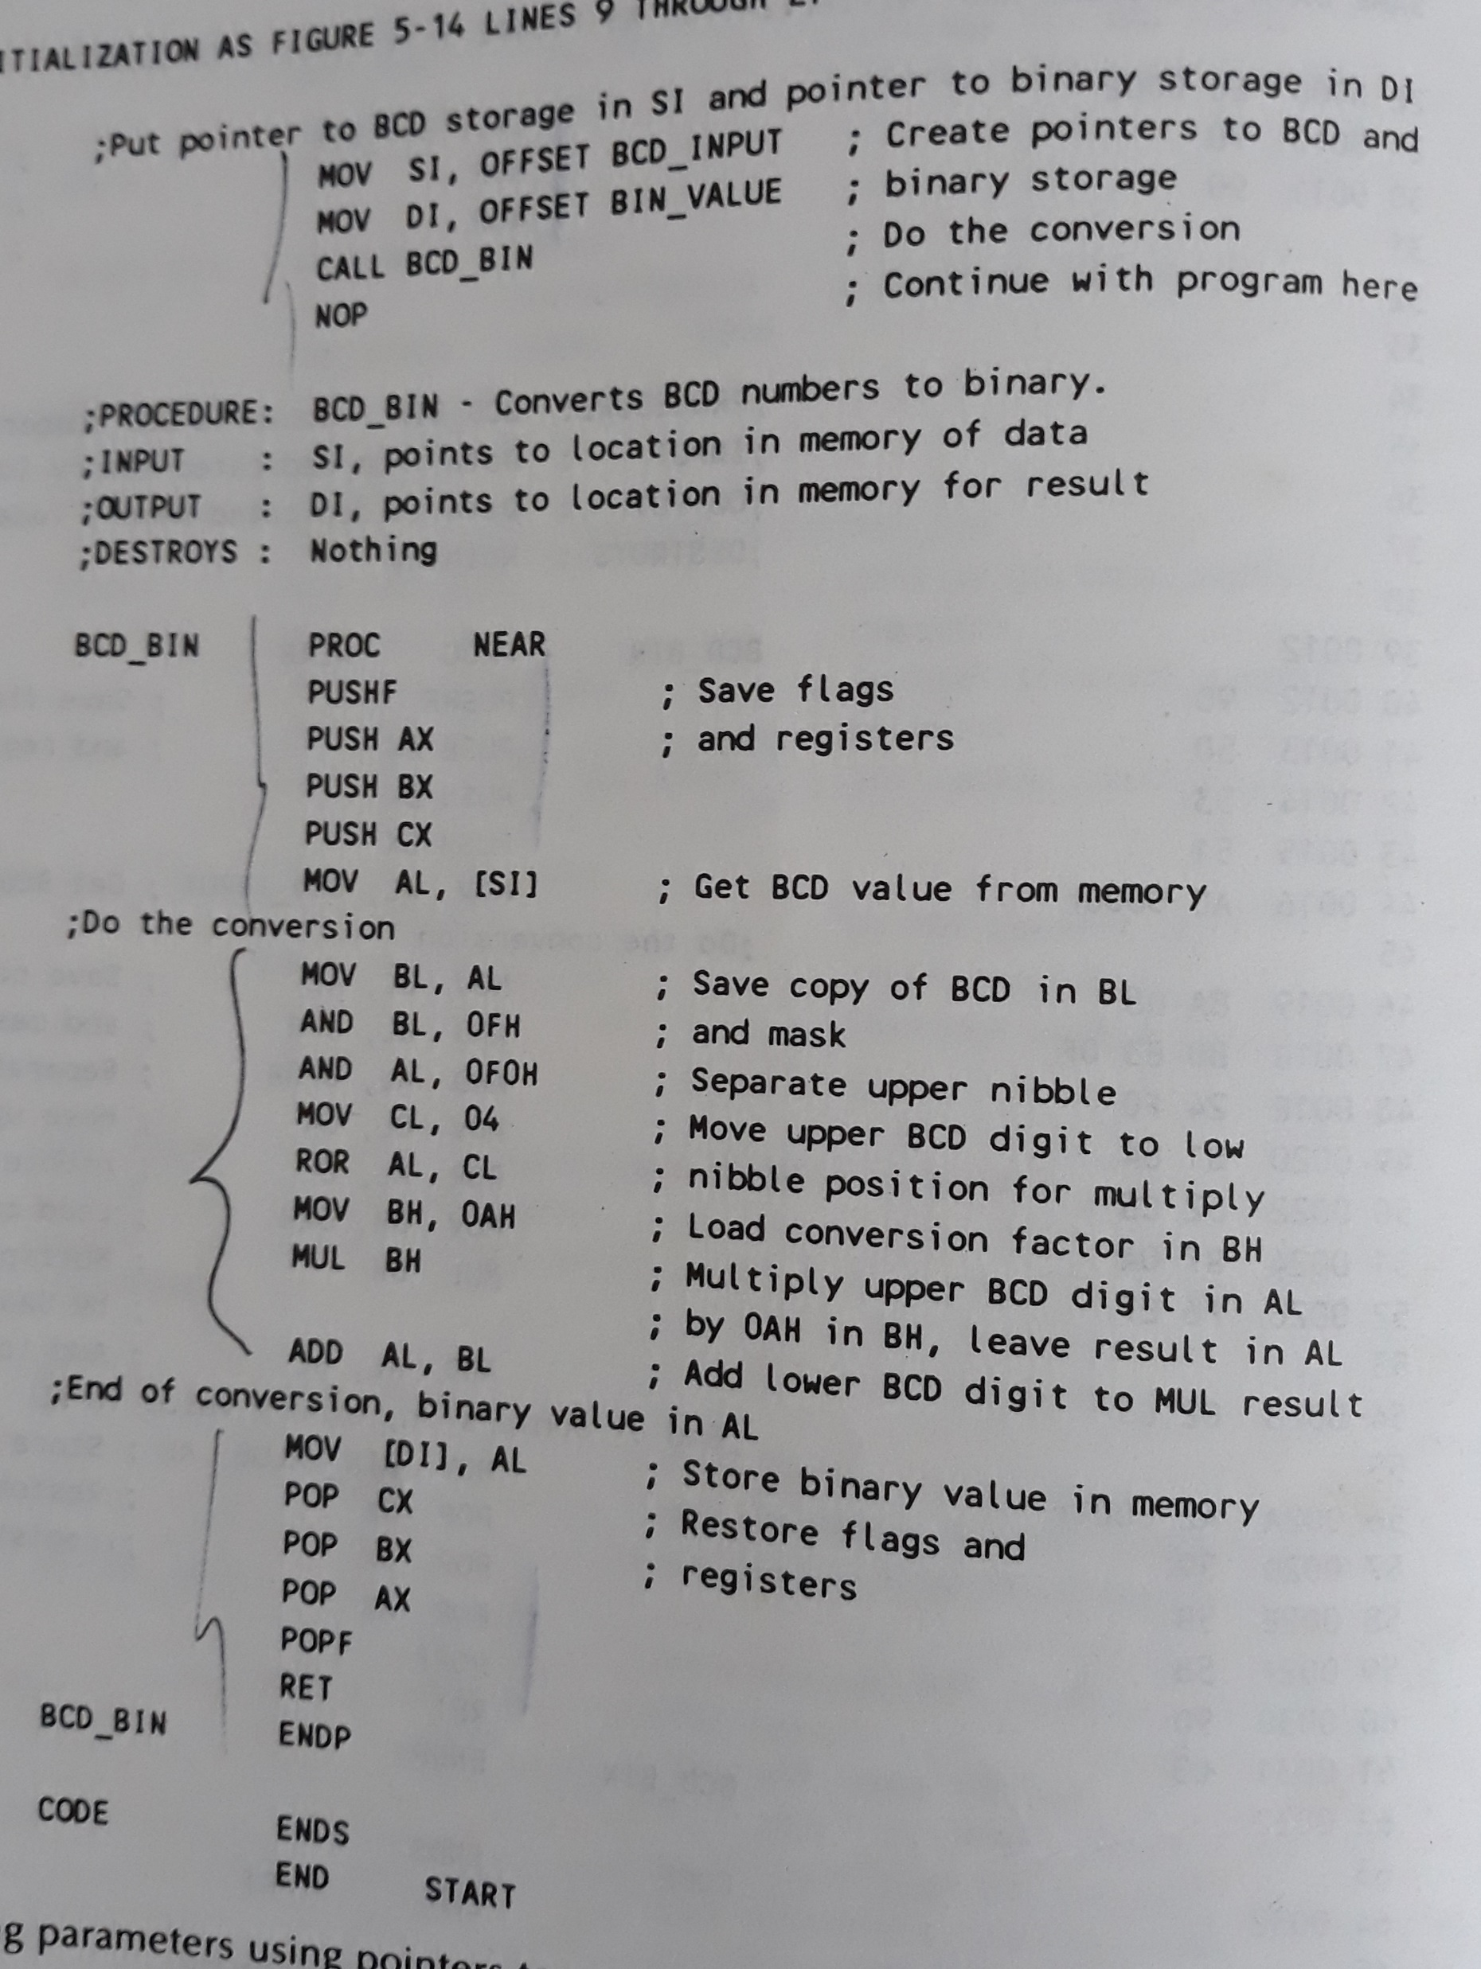

Passing parameters using pointers

Slide 20
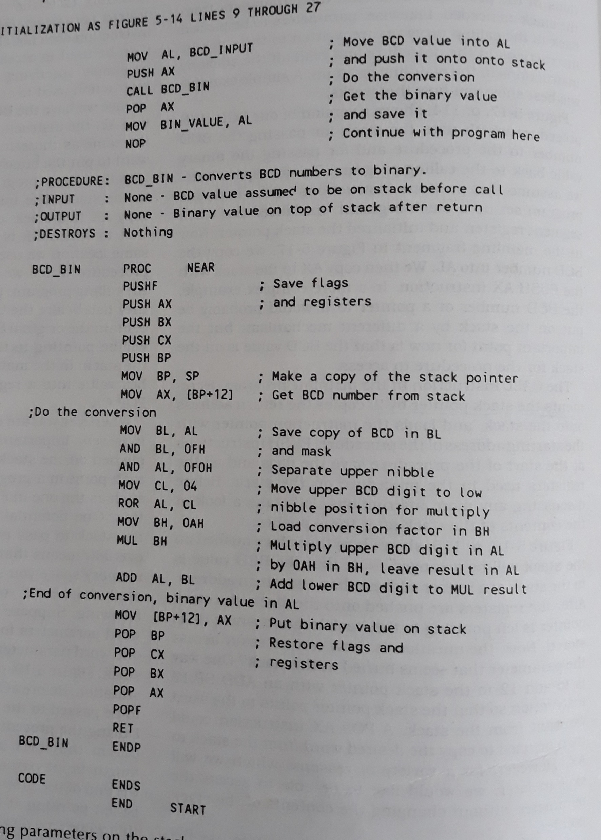

Passing parameters using the stack

Slide 21
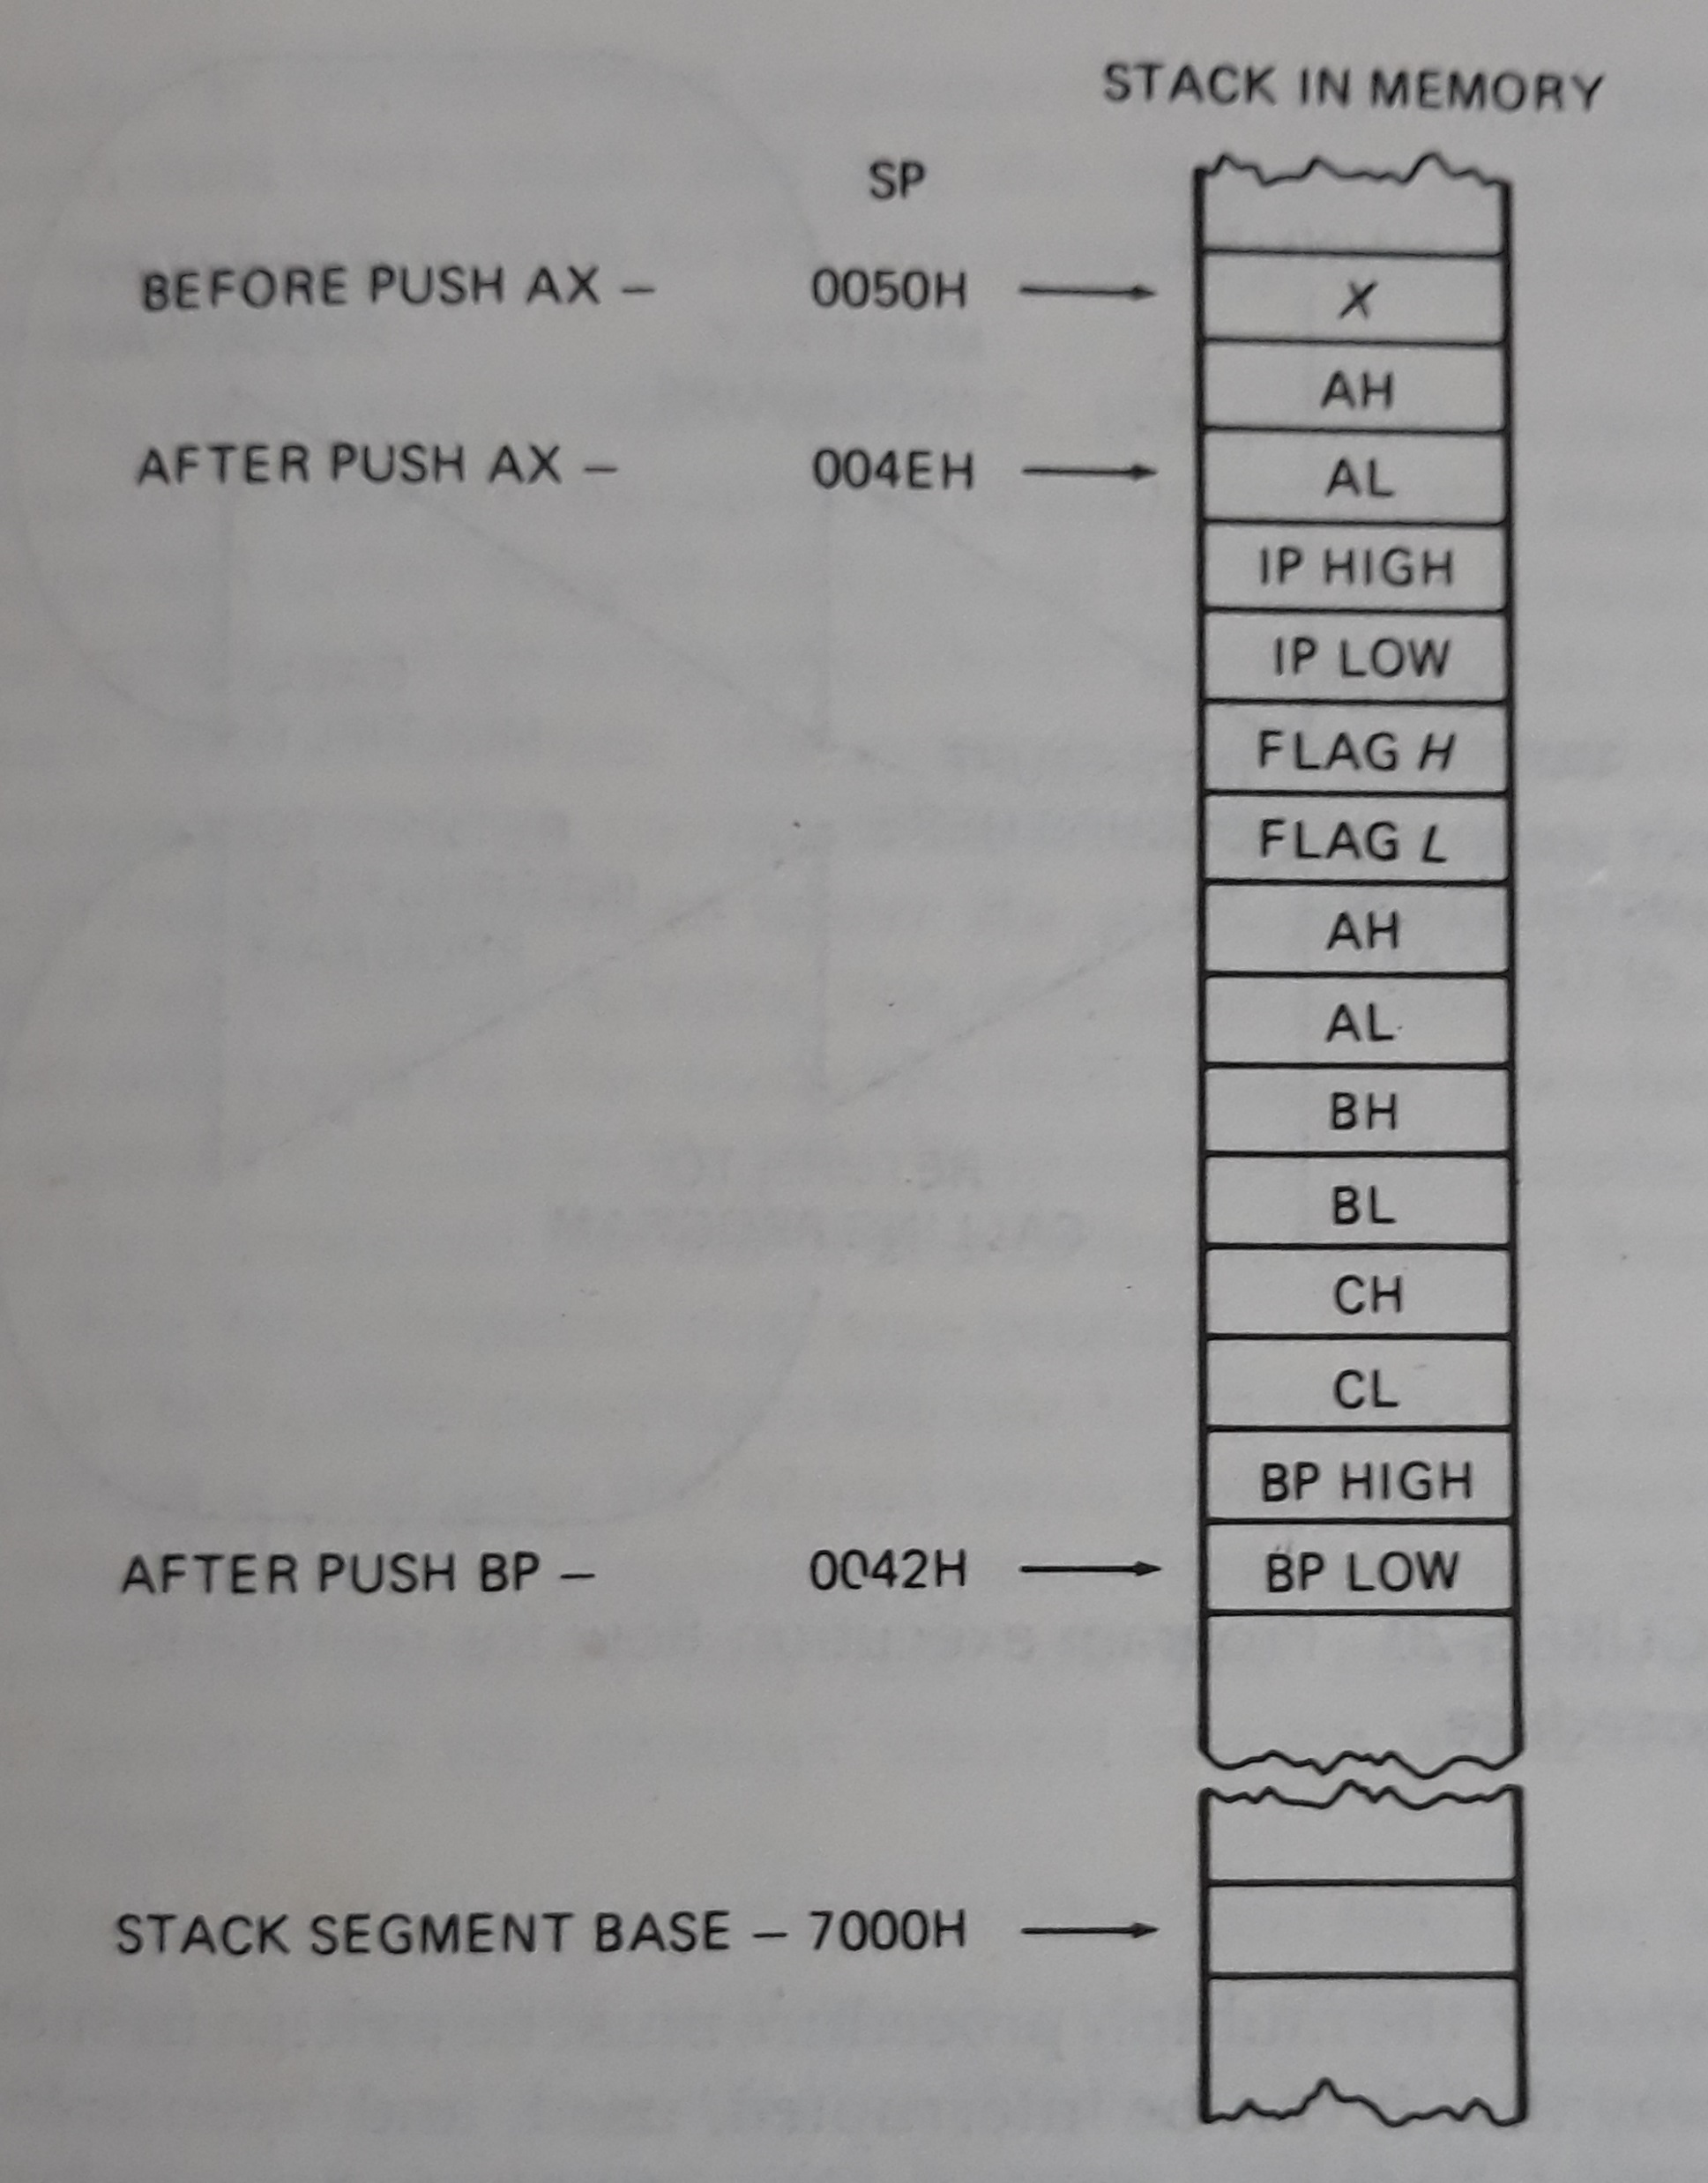

Slide 22
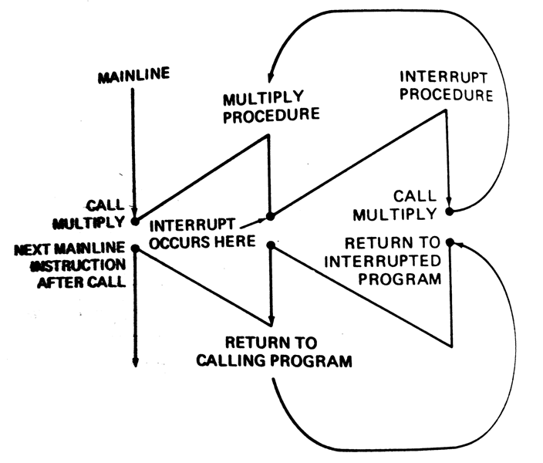
Reentrant Procedures

Slide 23
Recursive procedures
A recursive procedure is a procedures which call itself.
If N = 1 THEN factorial = 1
ELSE factorial = N * (factorial of N-1)

Slide 24
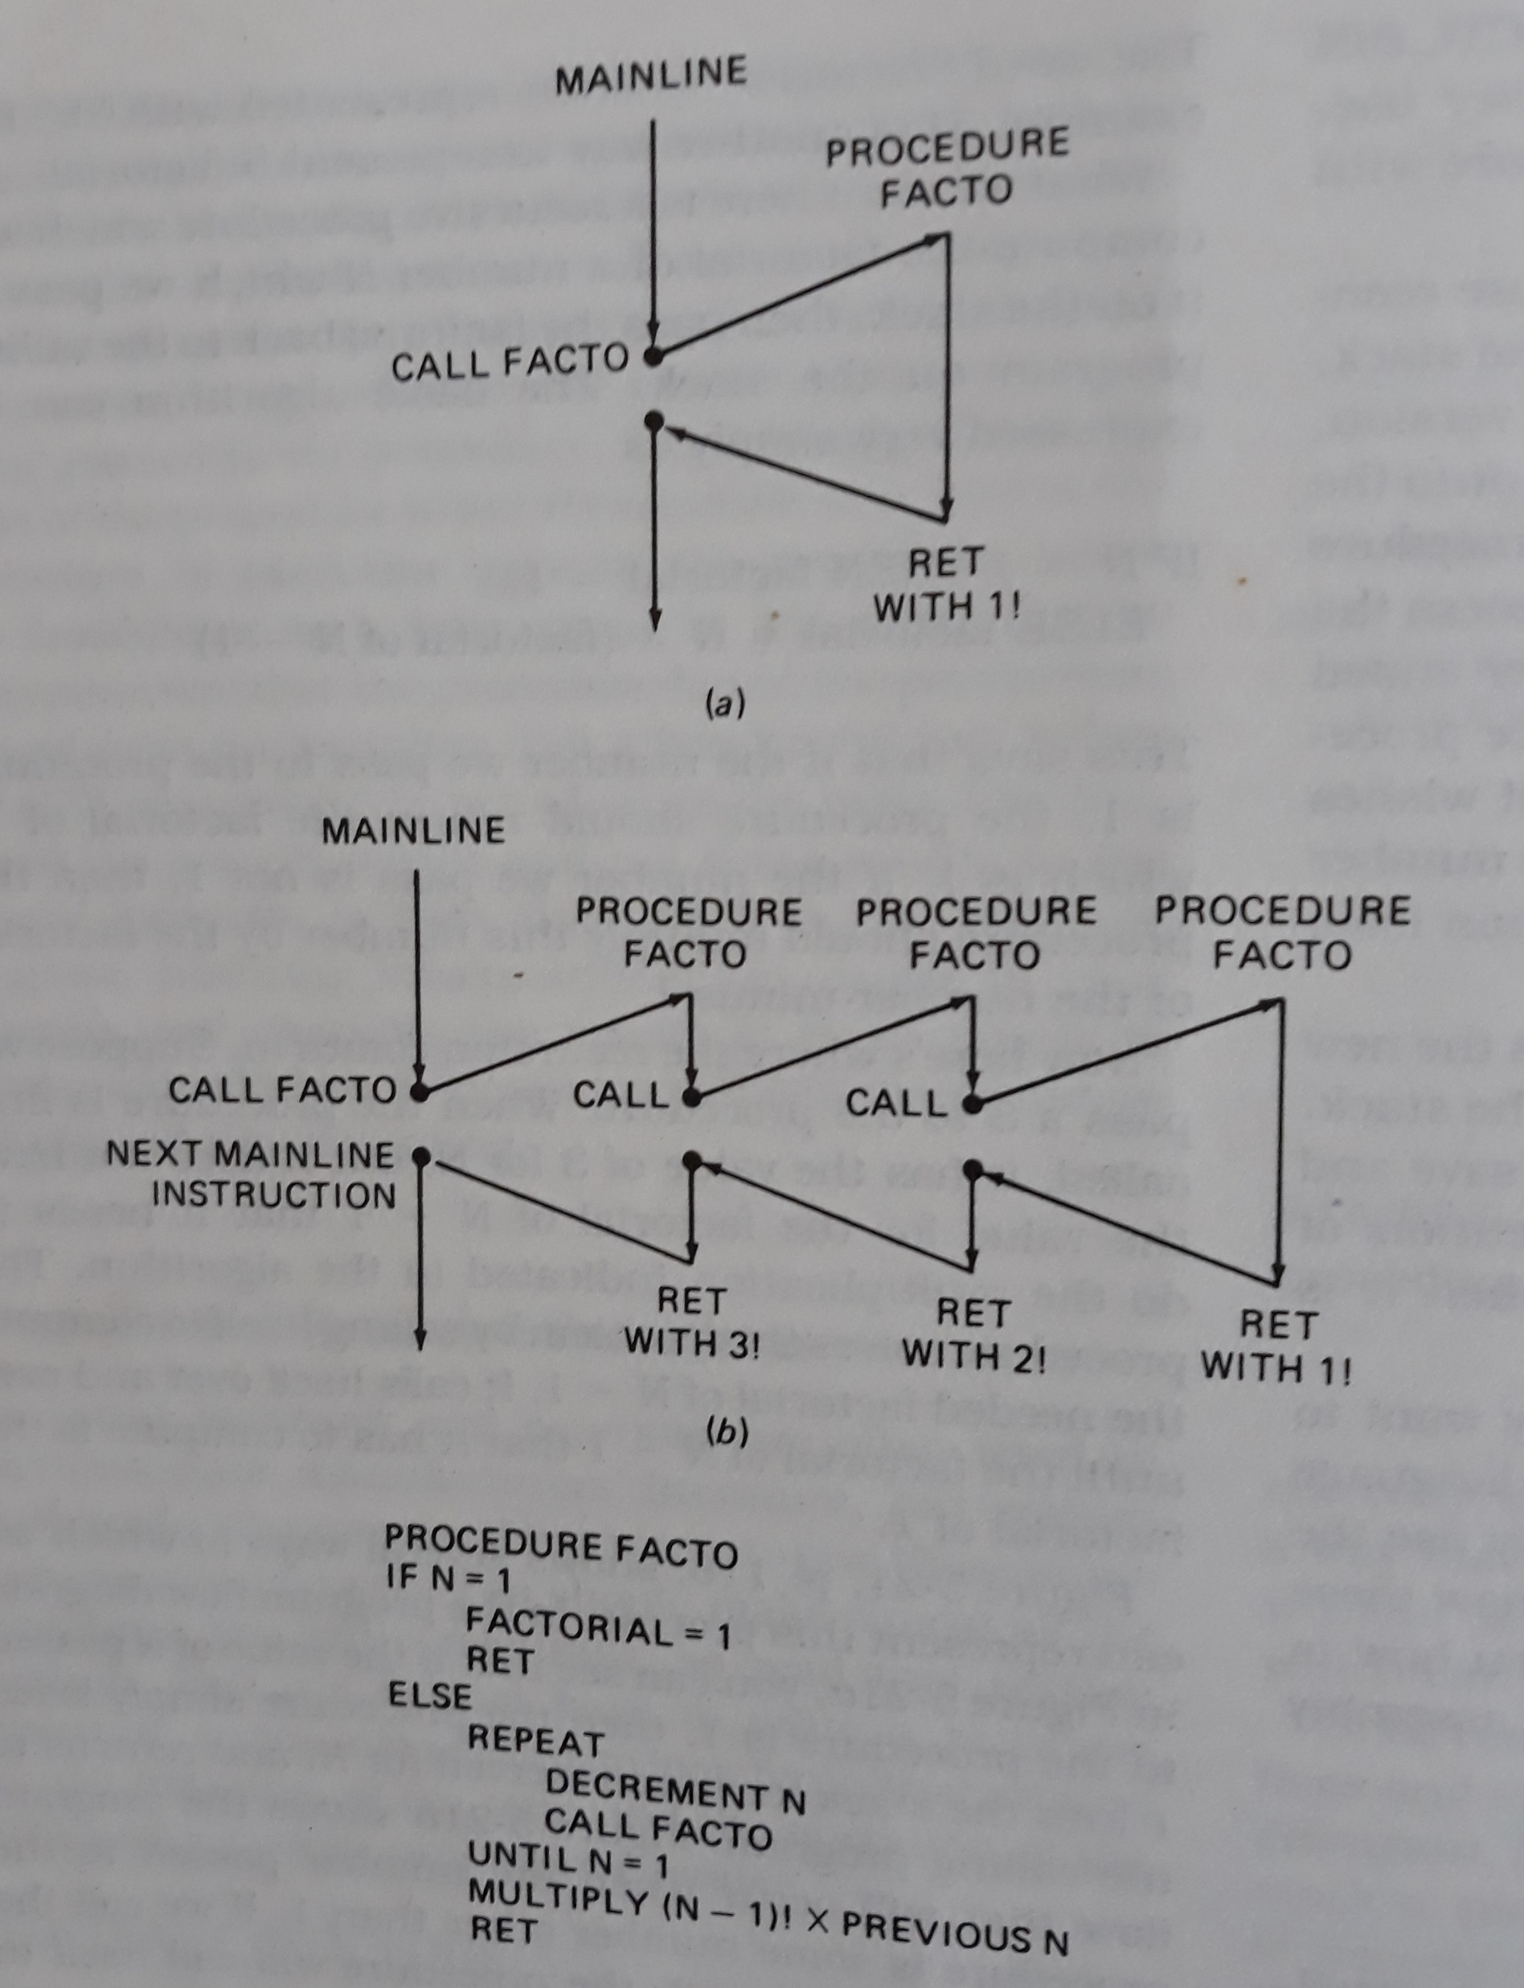
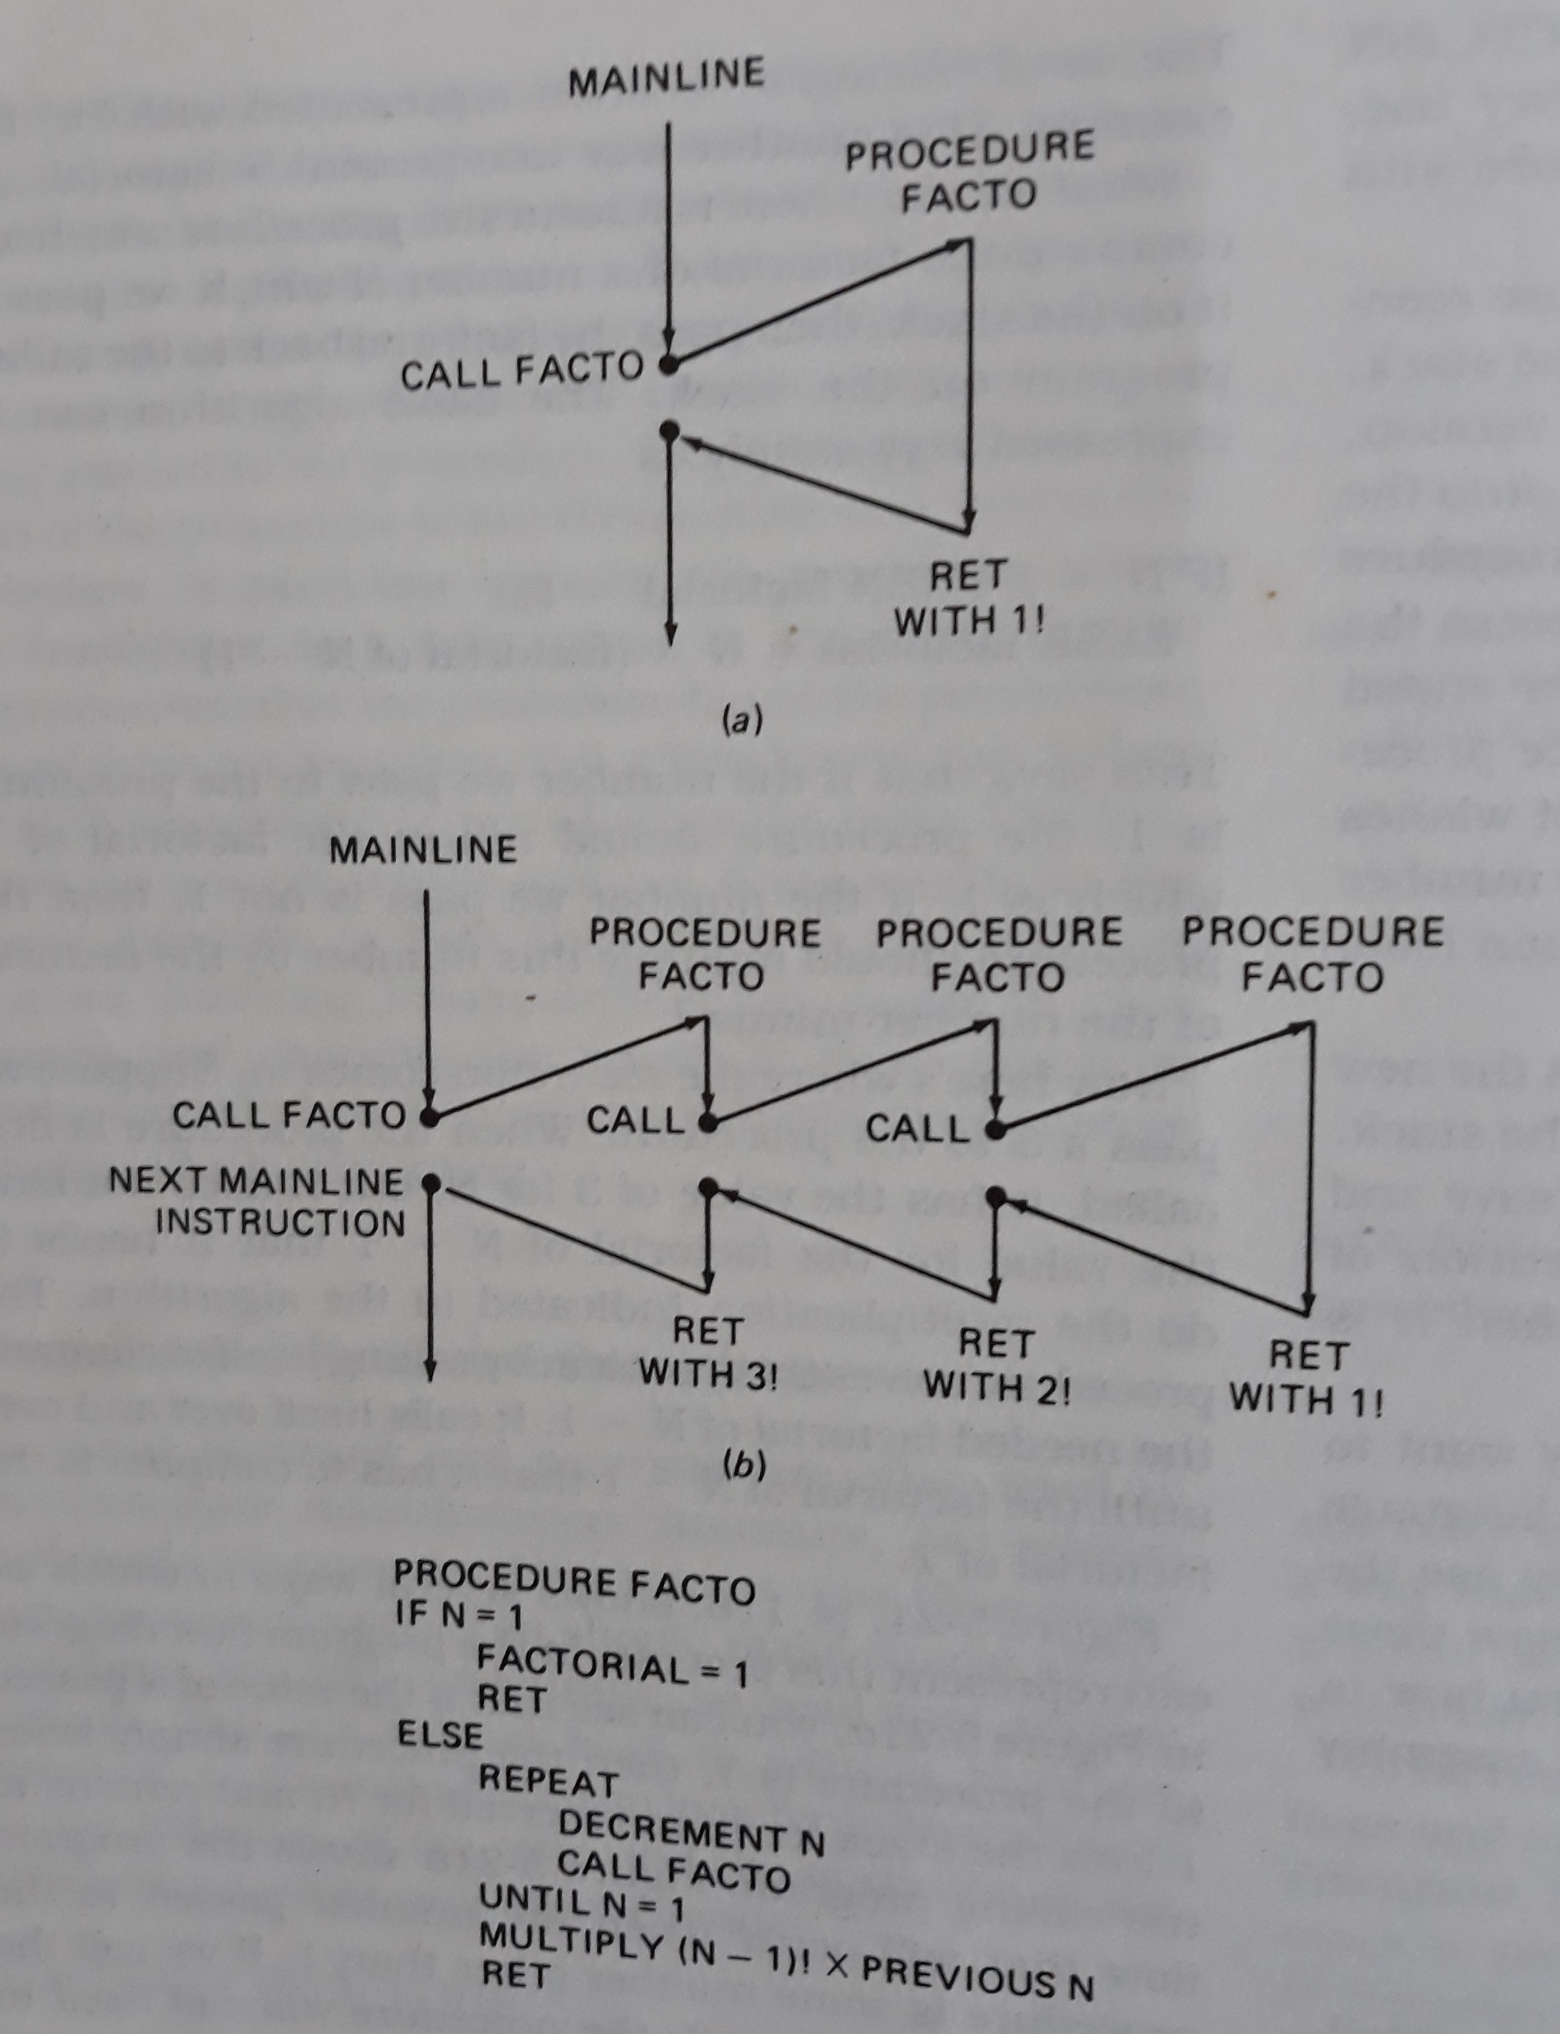
Factorial

Slide 25
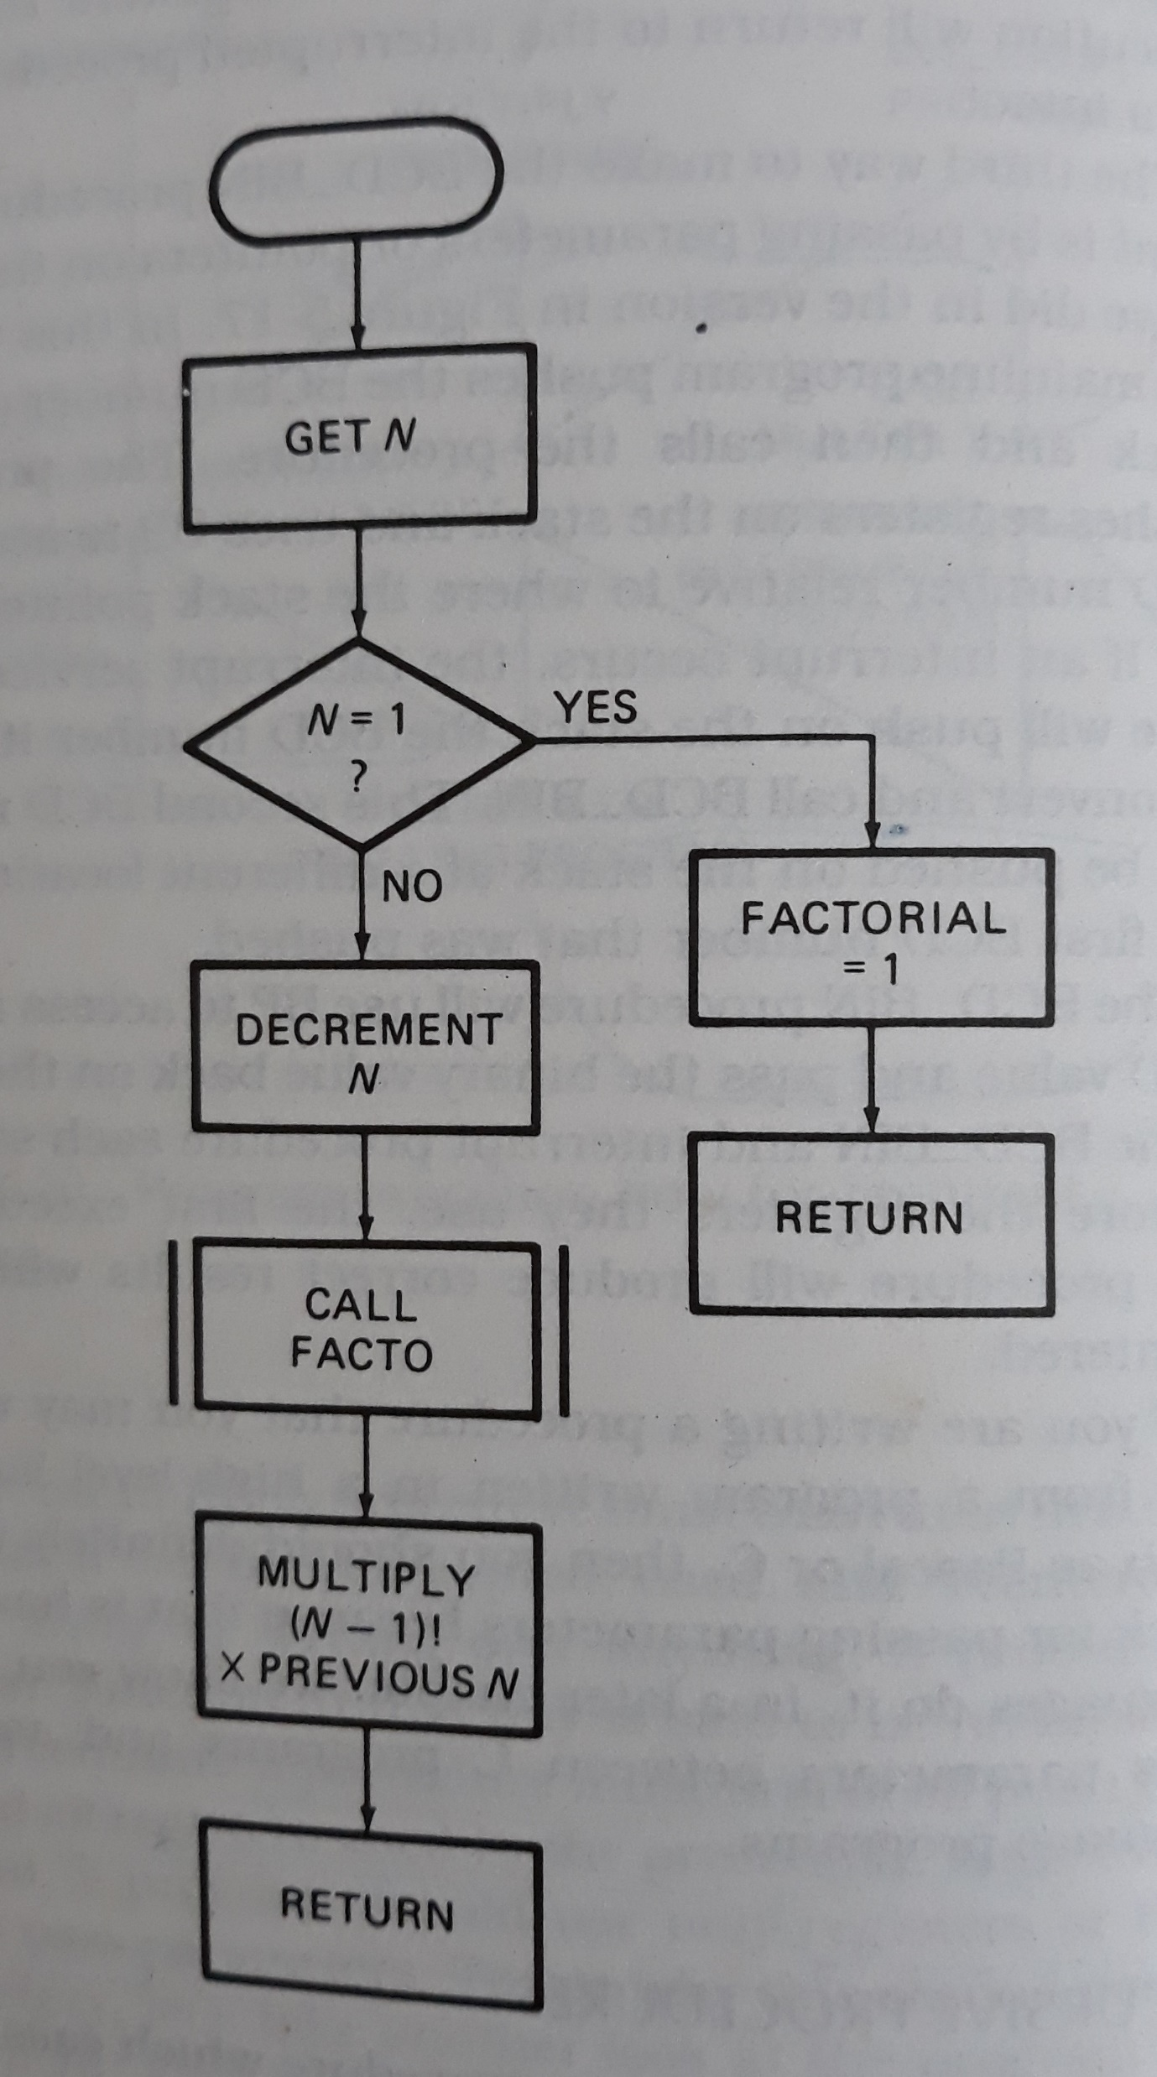
Flowchart

Slide 26
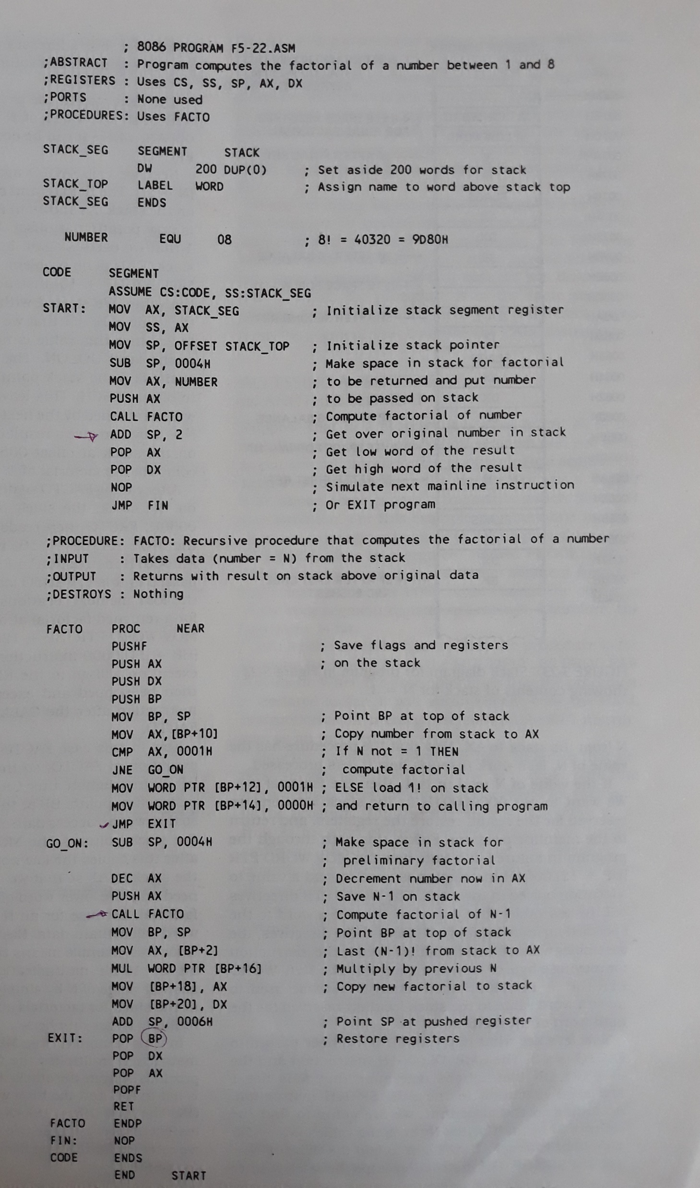
Calculate factorial of a number between 1 and 8

Slide 27
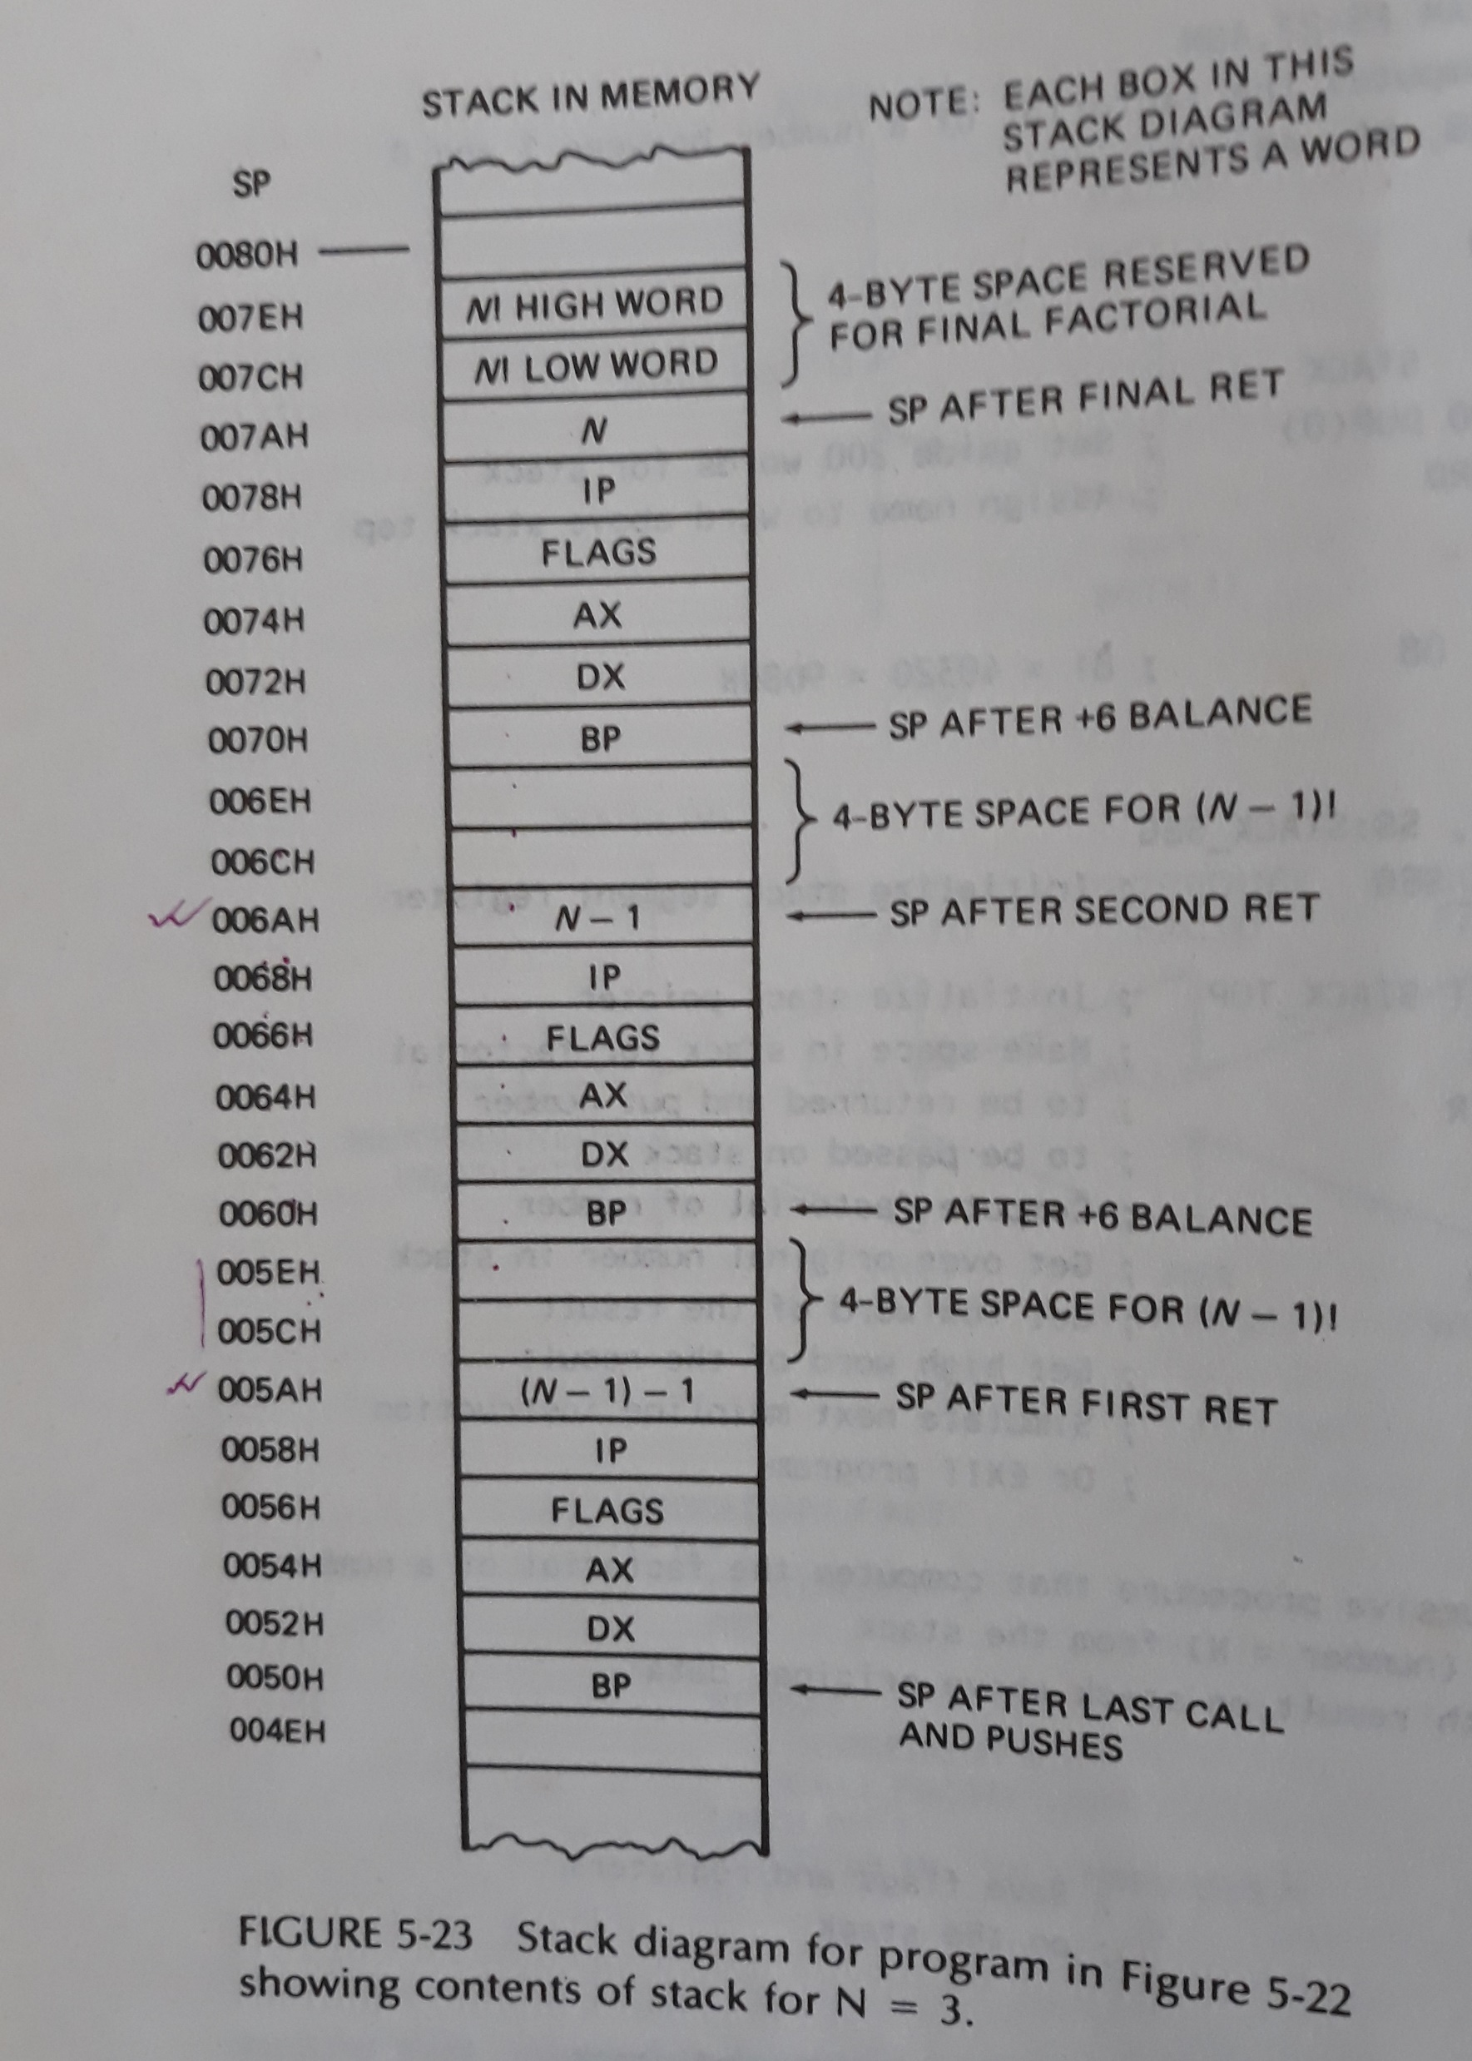

Slide 28
MACROS
A macro is a group of instructions we bracket and give a name at the start of the program.
Defining and calling macros without parameters:
PUSH_ALL MACRO
PUSHF
PUSH AX
PUSH BX
ENDM

Slide 29
Passing parameters to Macros
MOVE_ASCII MACRO NUMBER, SOURCE, DESTINATION
MOV CX, NUMBER
LEA SI, SOURCE
LEA DI, DESTINATION
CLD
REP MOVSB
ENDM
MOVE_ASCII 03DH, B_ST, B_ND

Slide 30
References
Microprocessors and Interfacing: Programming and Hardware Douglas V. Hall

